Slide 1
Rapid Adaptation
Pinus contorta
Data exploration

Slide 2
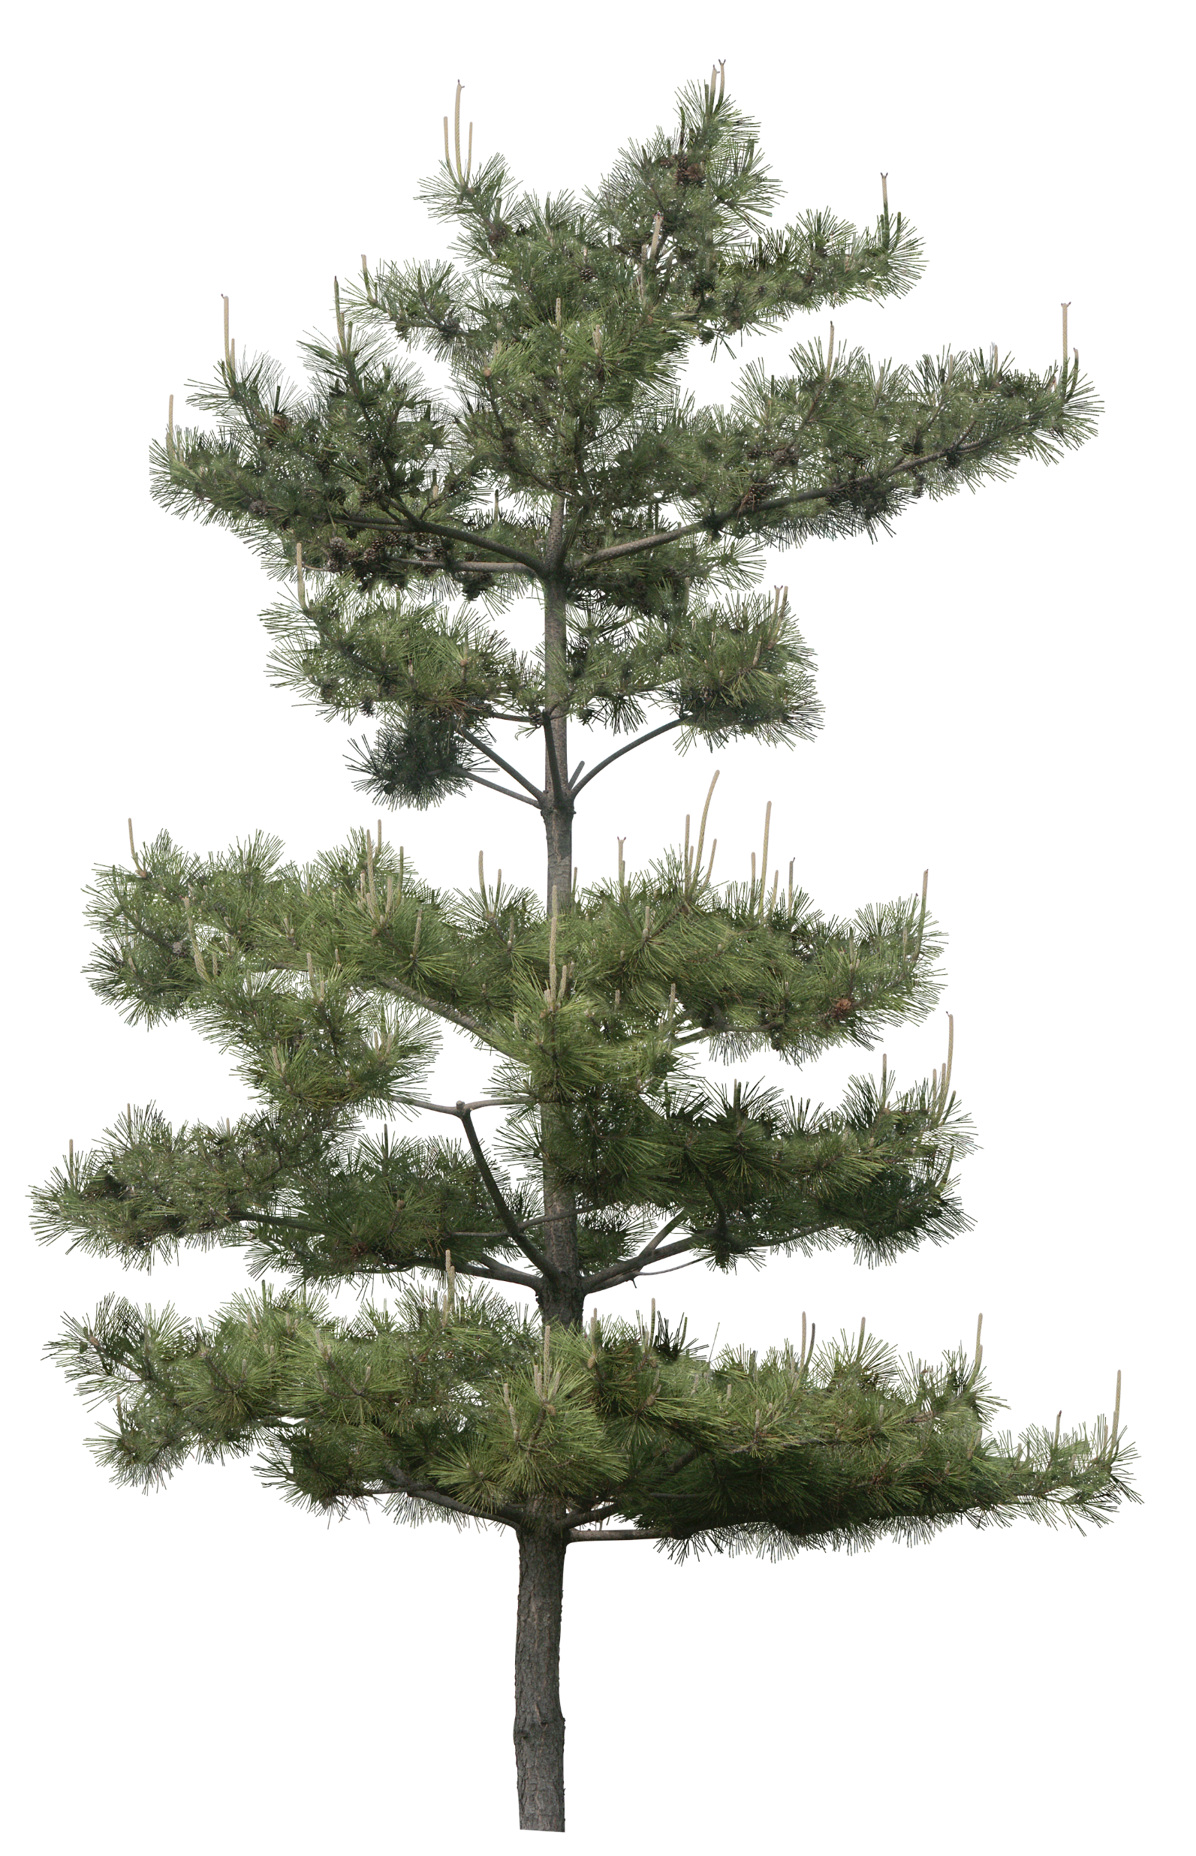
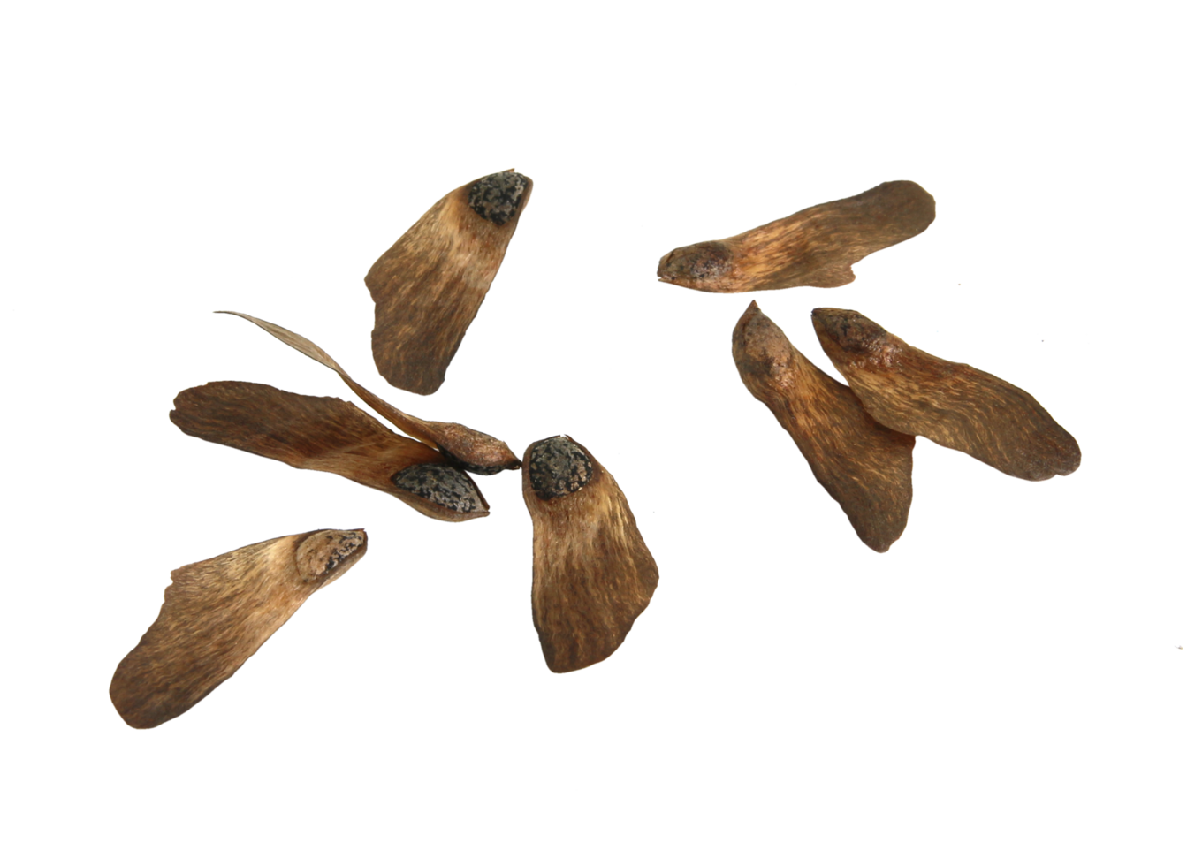
Study design
Change icons to Lodgepole pine!!!
Origin
Plantation
Regeneration
North Coast
Benmore
Rowens
Benmore
Rowens
Alaska
Skeena River
UKCEH
Notes:
Example: A regen tree from Benmore: mother is from Plantation in Benmore. Grandmother can be from Plantation in Alaska, North Coast or Skeena River.
Question: how rapidly do trees adapt to Scottish conditions?
Seeds that were brought from Origin have already germinated in UK conditions and grown to maturity and successfully reproduced in Plantations = first selection
Seeds that have come from Plantation have naturally germinated in local Scottish conditions = second selection
(Seeds from Regen have germinated in local UKCEH conditions = third selection for those that have not died?)
Treatment: seeds from all three locations = two years in seedling pots outside at UKCEH.
Family = half siblings from same mother tree (e.g., 50 or 10 seedlings)
Hypothesis: trees from regen grow better (taller). What about their resilience to disease, specifically Dothistroma? Have already coped with exposure to DNB in Scottish conditions and lived through exposure to produce seeds. Probably also most likely to stay green throughout bioassay.

Slide 3
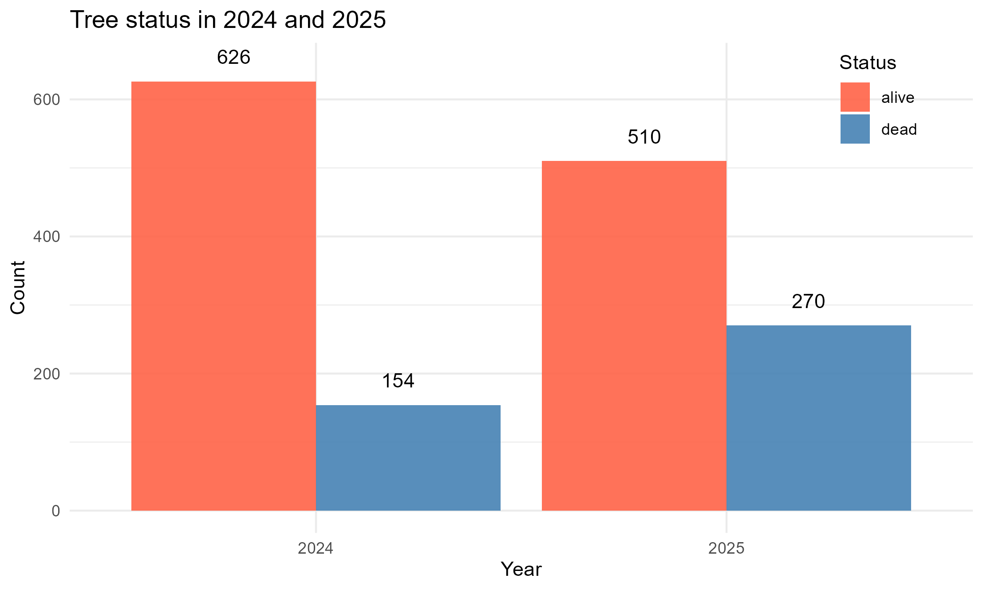
Tree status – 2024-2025
n = 780
-116

Slide 4
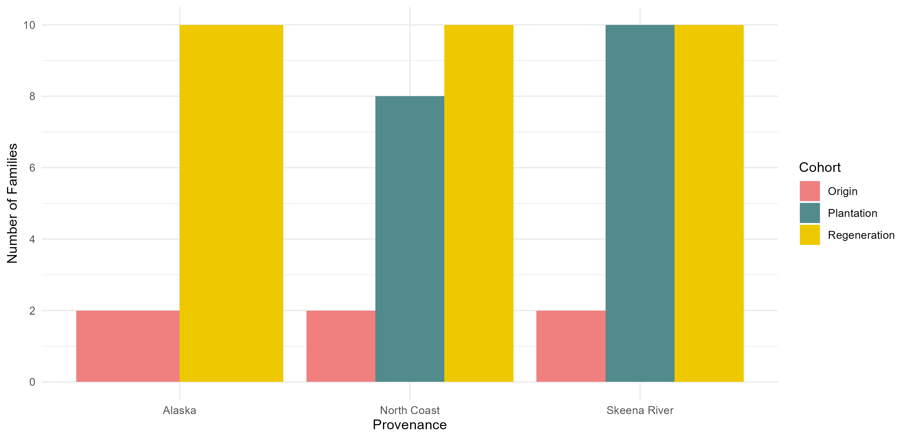
How many families from each Cohort & Provenance?
Notes:
2 provenance regions per provenance (e.g., Alaska) -> 2*3 = 6 families from origin
30 families from regen
10 seedlings per family for 10 families per provenance -> 100 seedlings per provenance
Plantation population from north coast region -> only 8 families -> 80 seedlings
No plantation with alaska origin

Slide 5
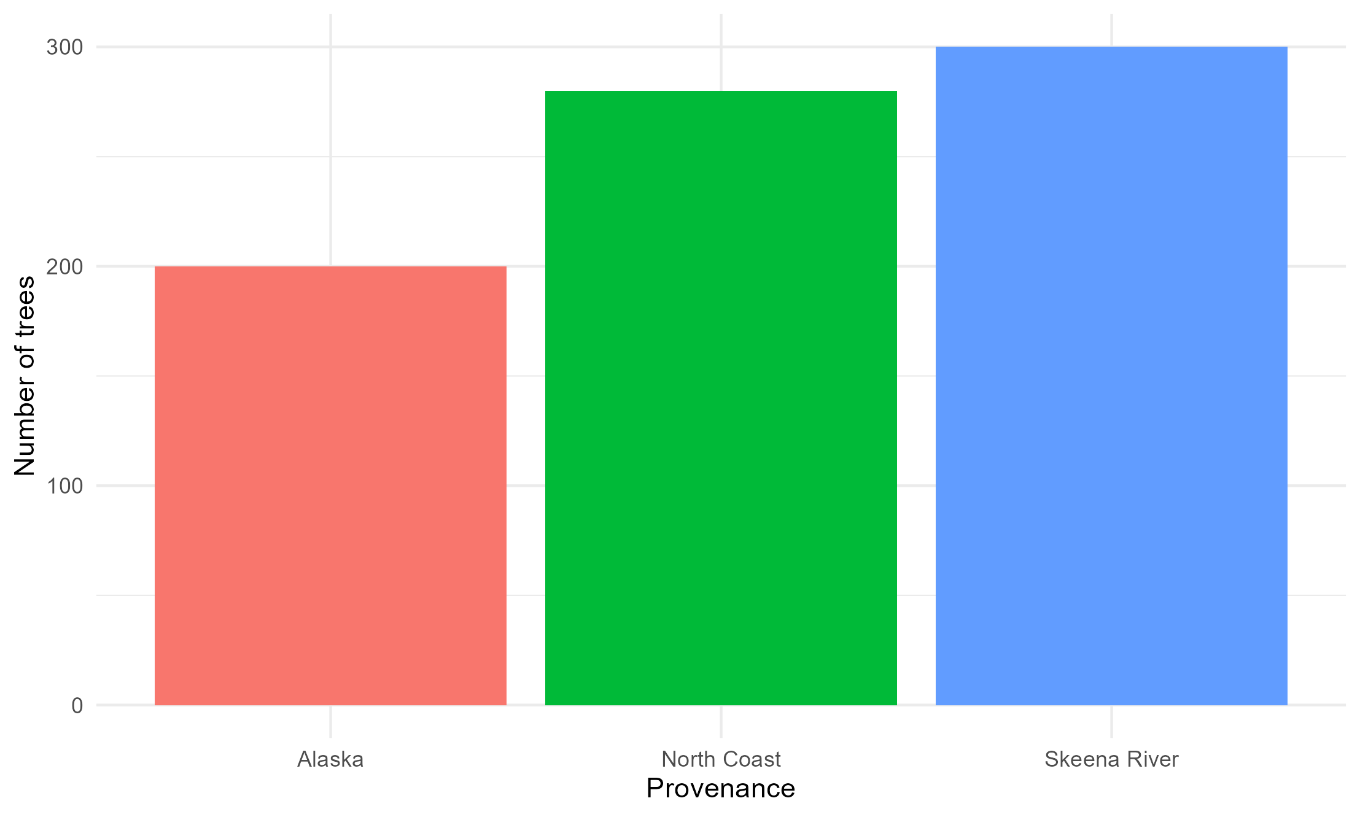
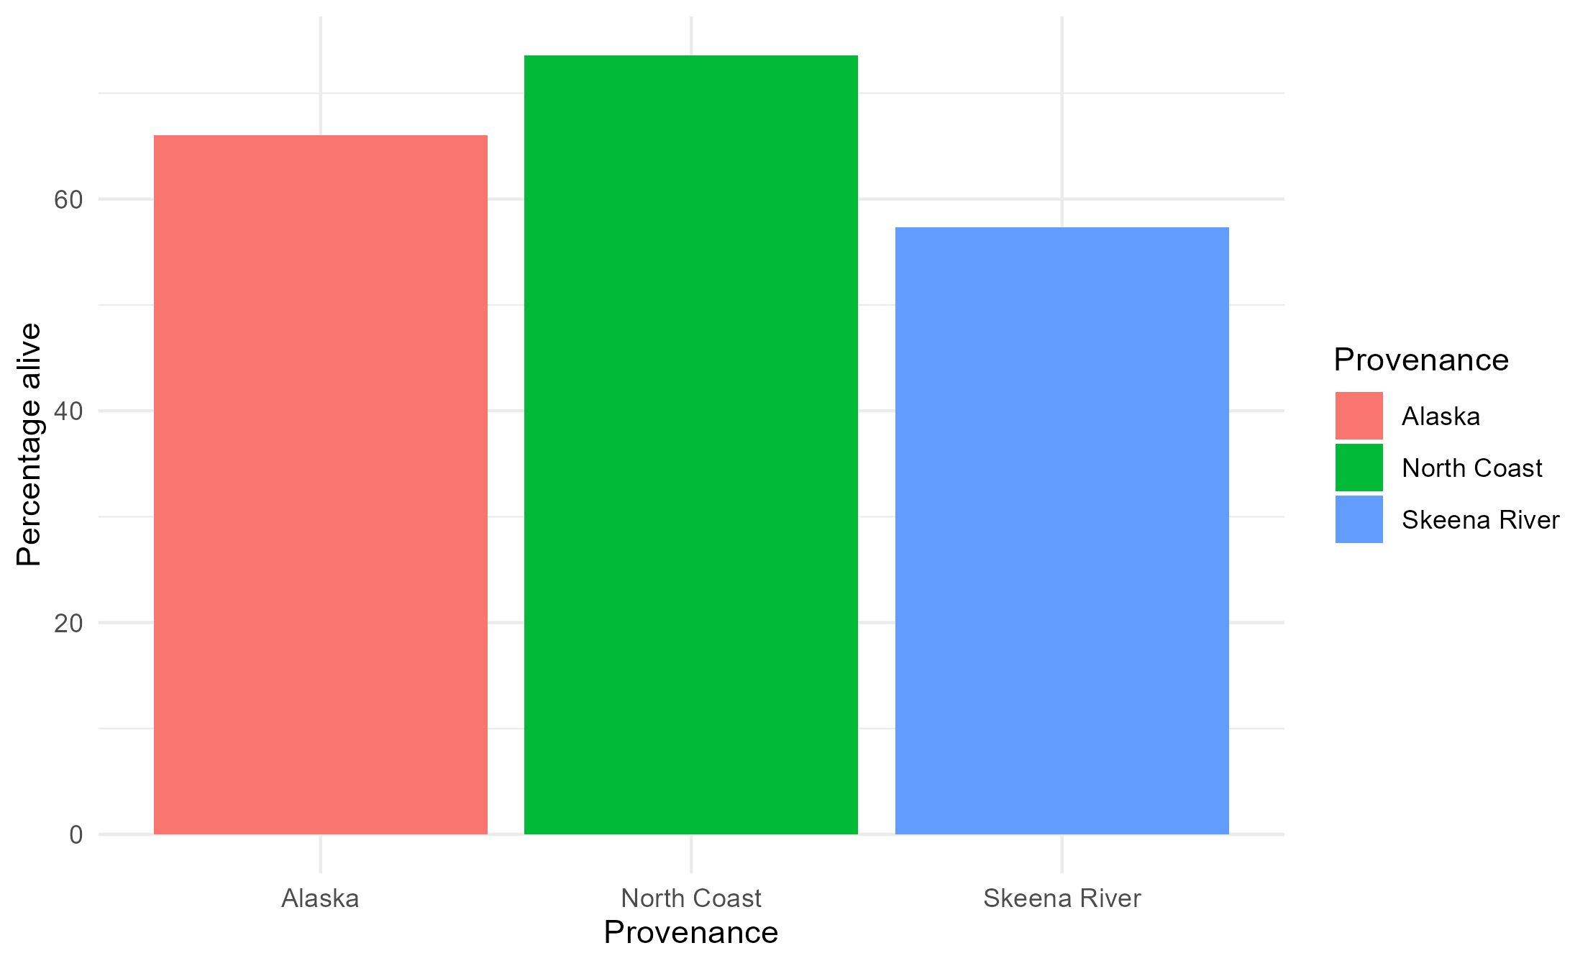
Provenance distribution
& status

Slide 6
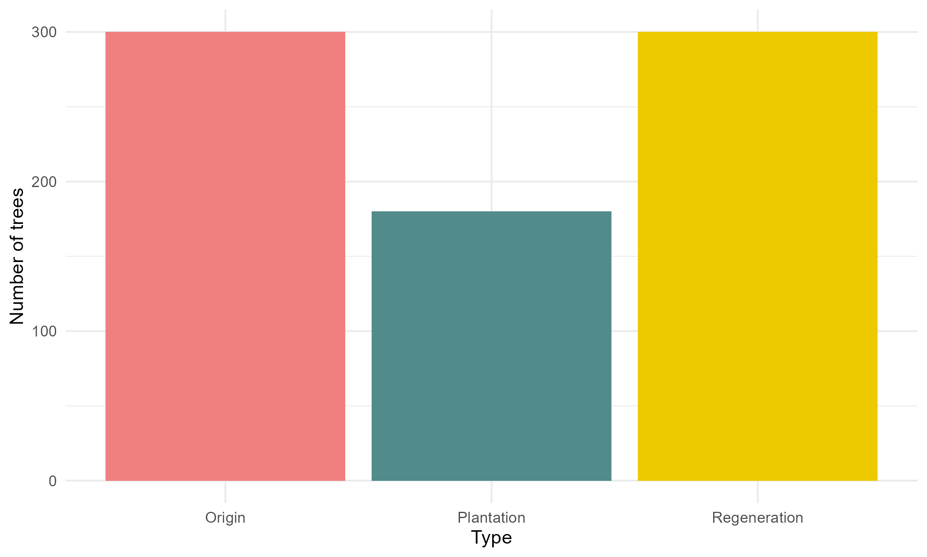
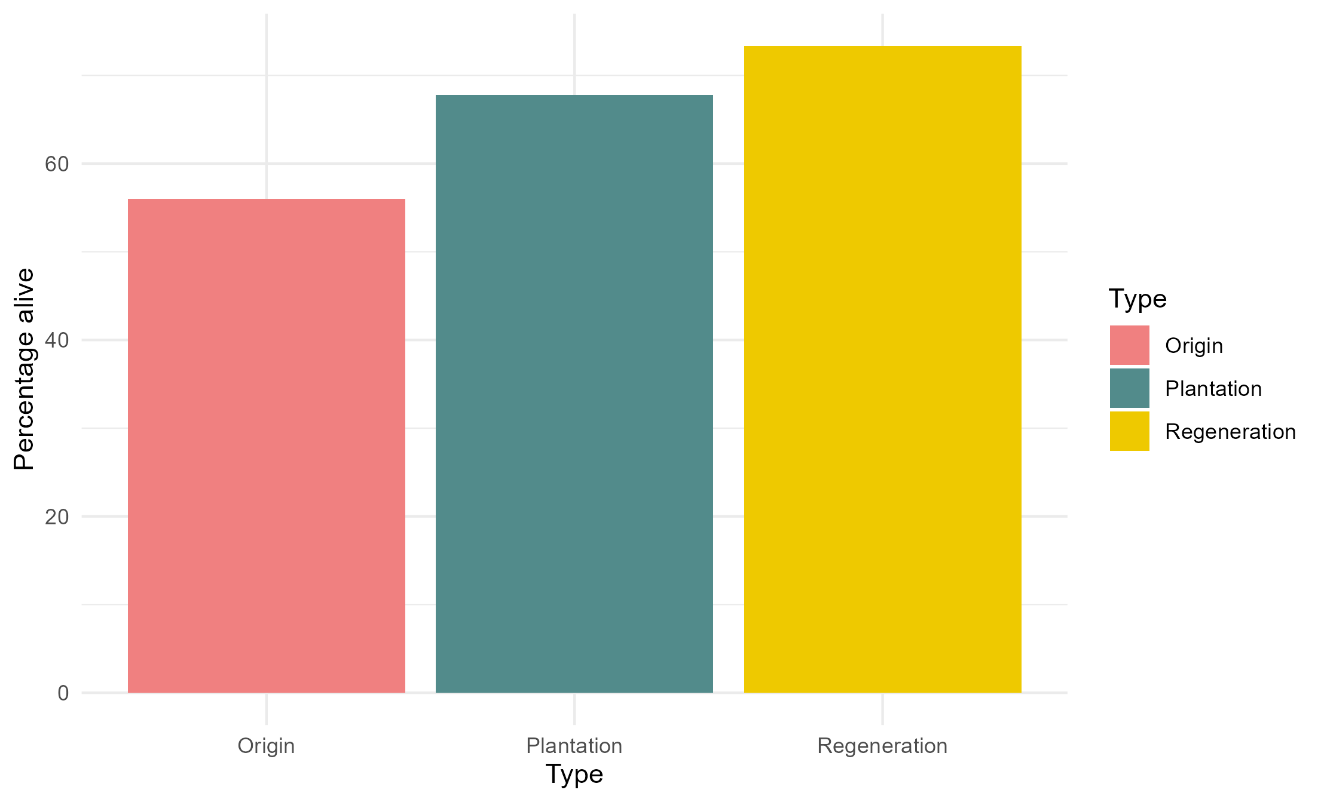
Cohort distribution
& status
Plantation: fewest trees but medium survival
Origin = least survival
Regen = most survival
Notes:
Combine -> initial number of trees next to proportion/number that survived (two different y axes or annotations on top of bars)

Slide 7
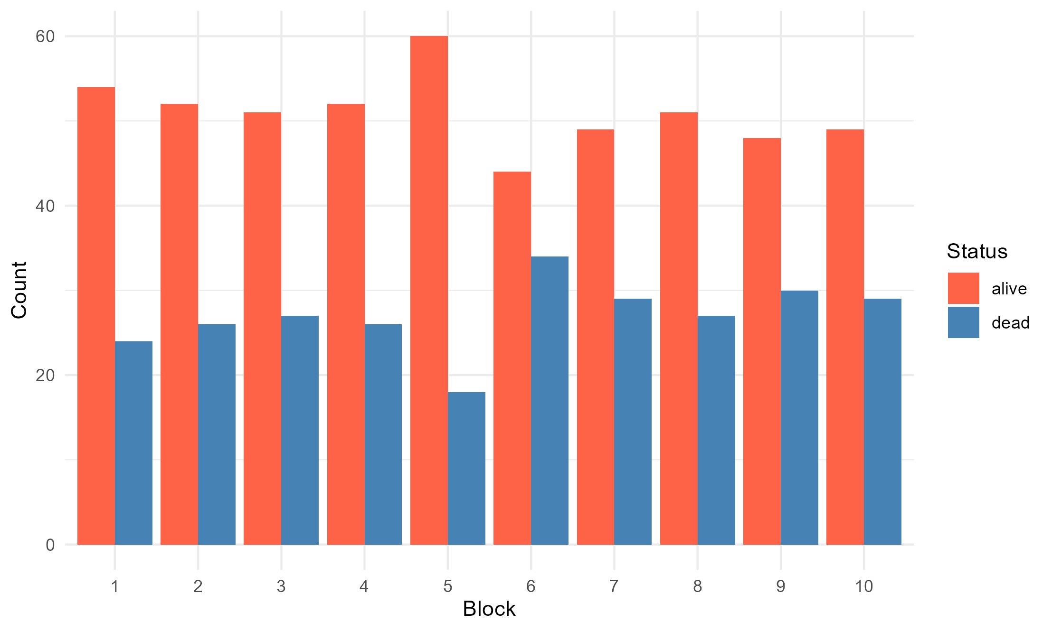
Status – by Block
No major influence of block except maybe 5 & 6 (edges of benches)

Slide 8
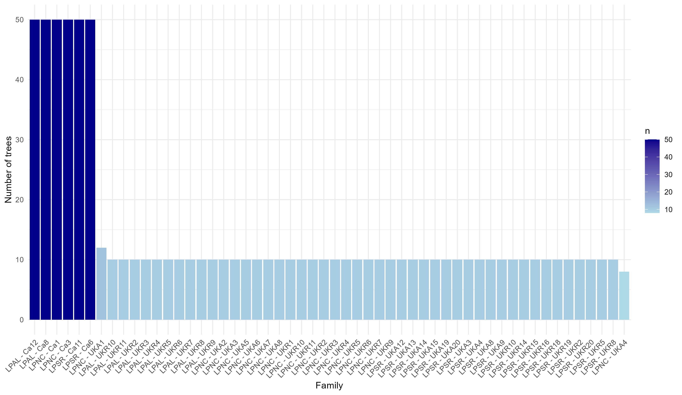
Family distribution
Notes:
6 families have 50 seedlings
Most have 10
This is not accurate information. This is families across all provenances but for origin don’t really have family-level data. Don’t fully understand but basically irrelevant.

Slide 9
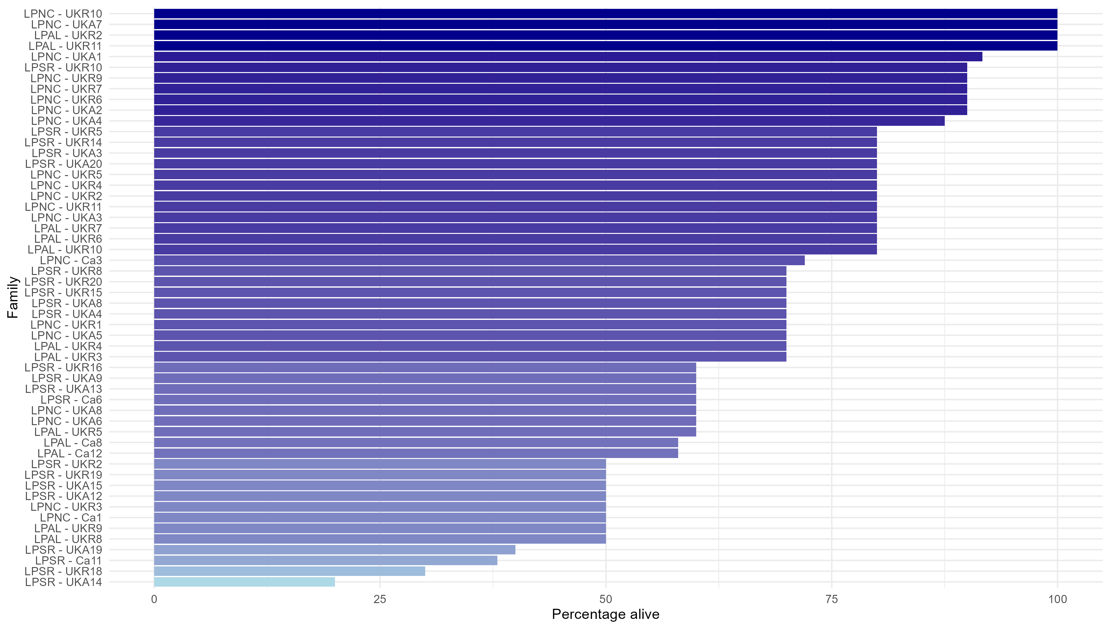
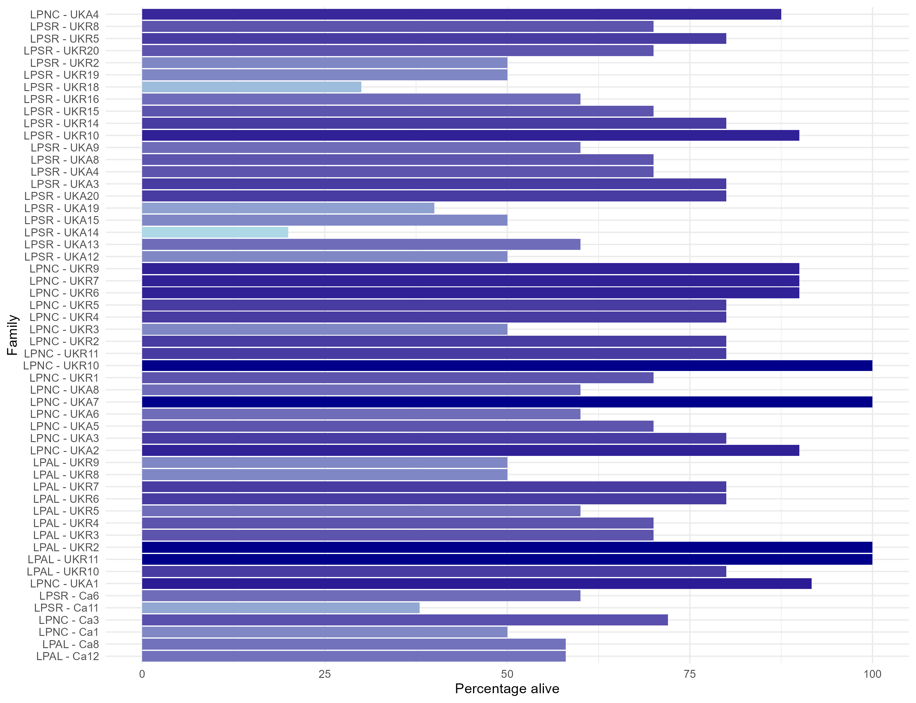
Status – by Family
Arranged by percent alive -> families have different numbers of initial trees but same percentage alive
Bottom – fewest trees per family
Notes:
Alignment is random: 50% survival could come from 5/10 or 50/100 seedlings
Graph is ordered by survival rate
→ could order by initial number of trees

Slide 10
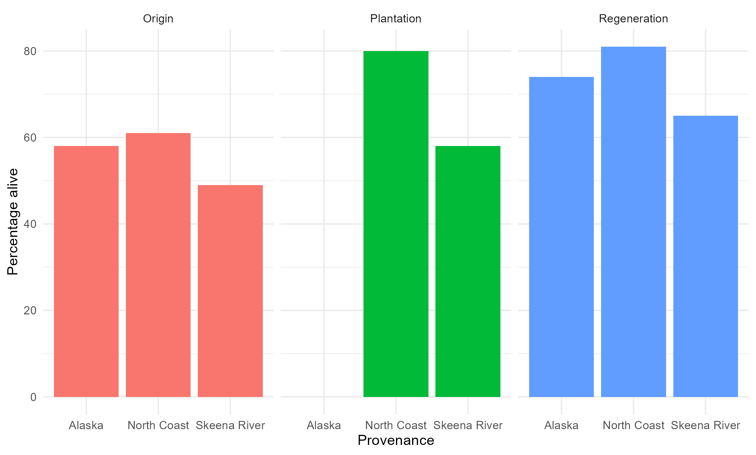
Interaction – Provenance and Cohort
GLMM: Status ~ Cohort + Provenance + Type * Provenance + (1 | Family)
Provenance has strongest effect (14% of variation) and Cohort (cohort) also strong effect (11%)
Interaction not strong.
Notes:
Survival probably different between trees from Provenances and Cohort. E.g., if you’re from Skeena River in Origin = with some confidence not likely survival
Type: npar = 2 | sum sq = 11.65 | mean sq = 5.83 | f value = 5.83
Provenance: npar = 2 | sum sq = 14.27 | mean sq = 7.13 | f value = 7.13
Type*Provenance: npar = 3 | sum sq = 1.1 | mean sq = 0.37 | f value = 0.37

Slide 11
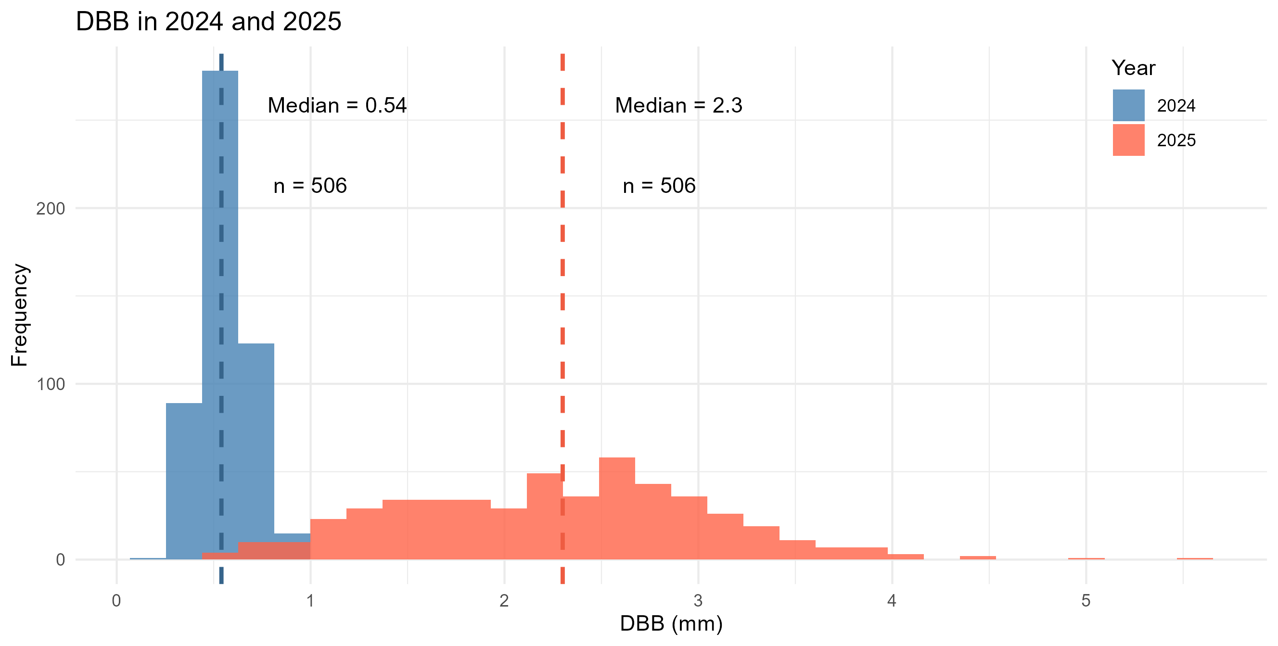
DBB
506 trees that are alive at both timepoints have DBB measurements

Slide 12
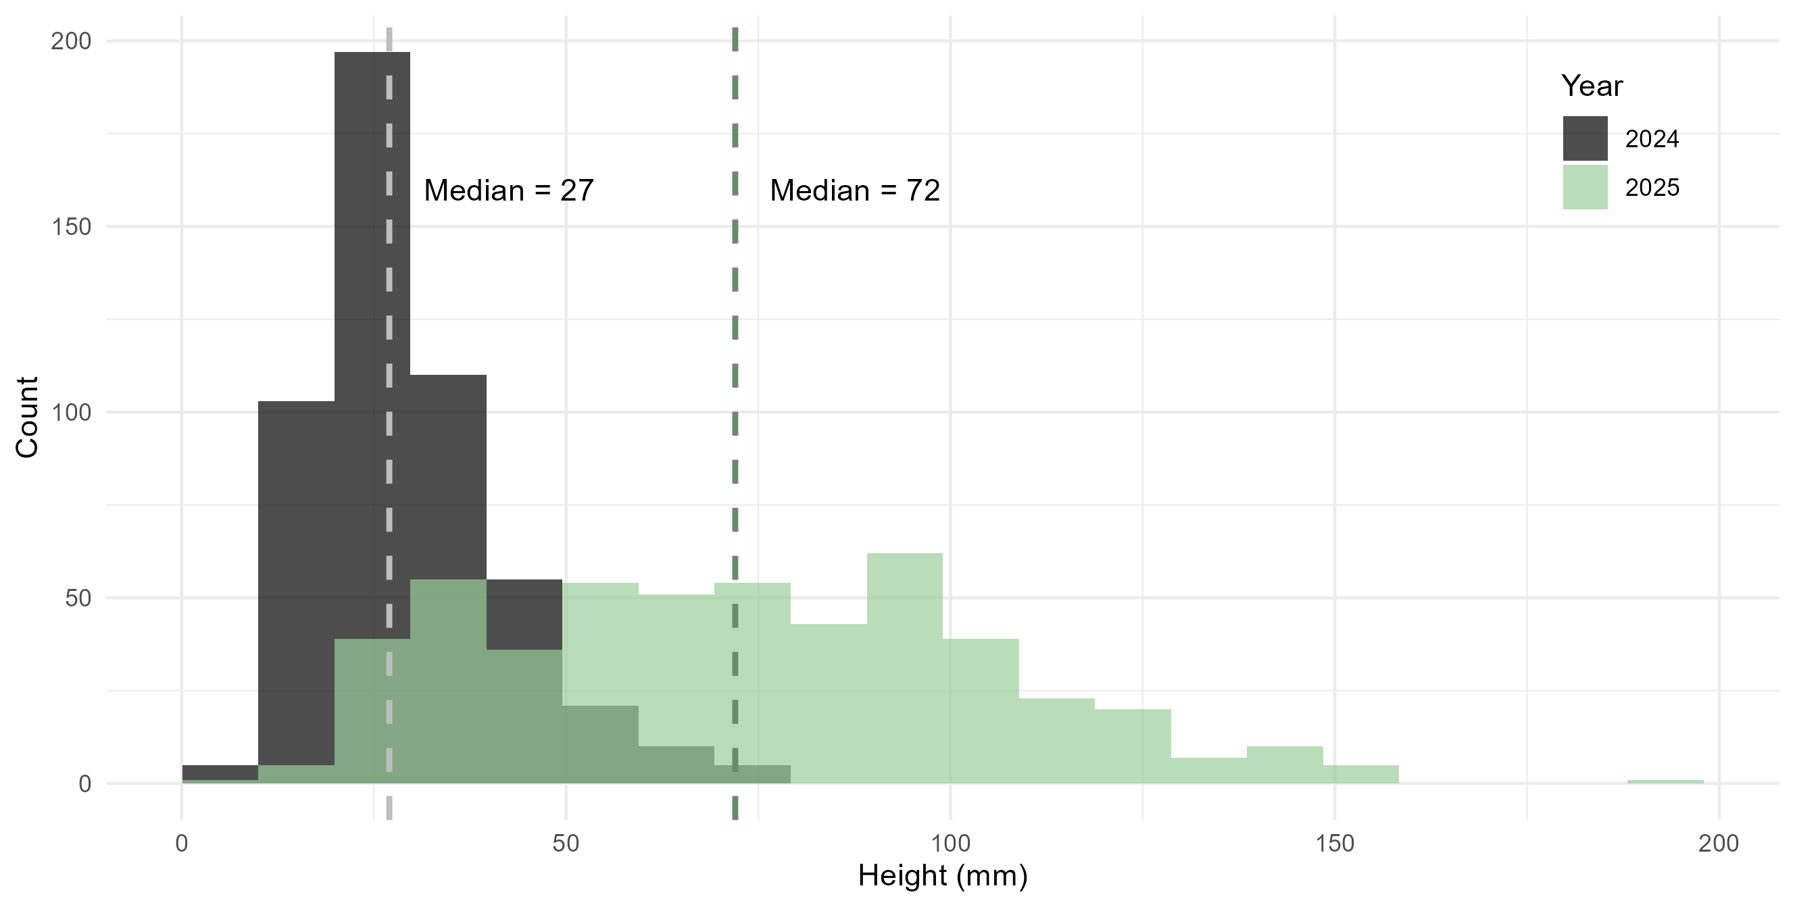
Height
506 trees that are alive at both timepoints have height measurements
1 tree is alive at both and has DBB but not height

Slide 13
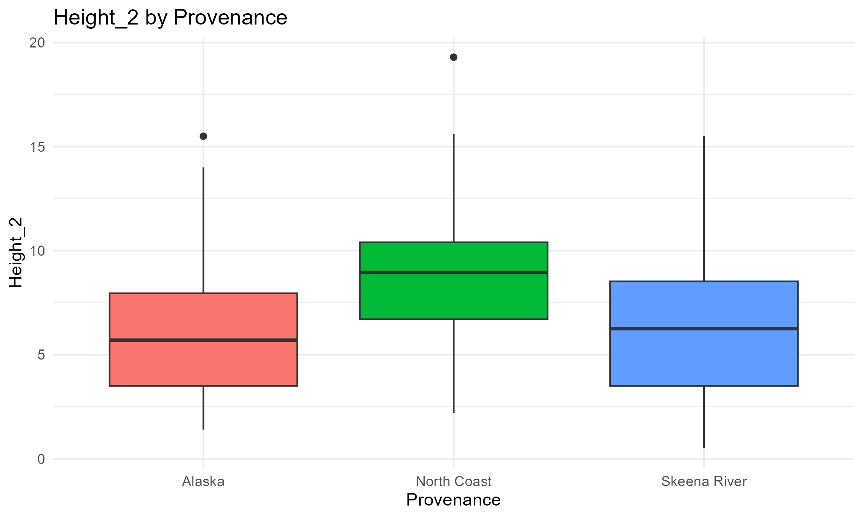
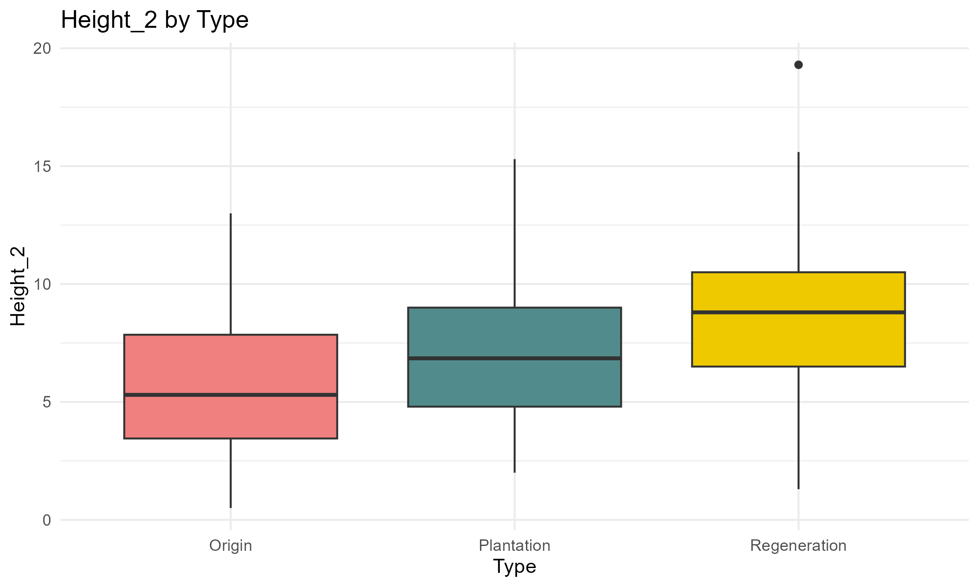
Height – by Provenance & Cohort
*
*
Trees from North Coast & Regeneration significantly taller
*
*
*

Slide 14
Summary so far...
Origin trees overall shorter & less alive
Worst combo: Origin & Alaska
Regen trees overall taller & more alive
Best combo: Regen & North Coast

Slide 15
Budset & Budburst
Date of planting: 20-23/6/2023
Budset period: 11/9/2023 – 17/5/2024
Budburst period: 2/2/2024 – 22/5/2024
Sample sizes:
Budset: 549 trees
Budburst: 575 trees
(Maybe 26 didn’t have noticeable buds?)
Budset & Budburst: 529 trees have data (~85%)

Slide 16
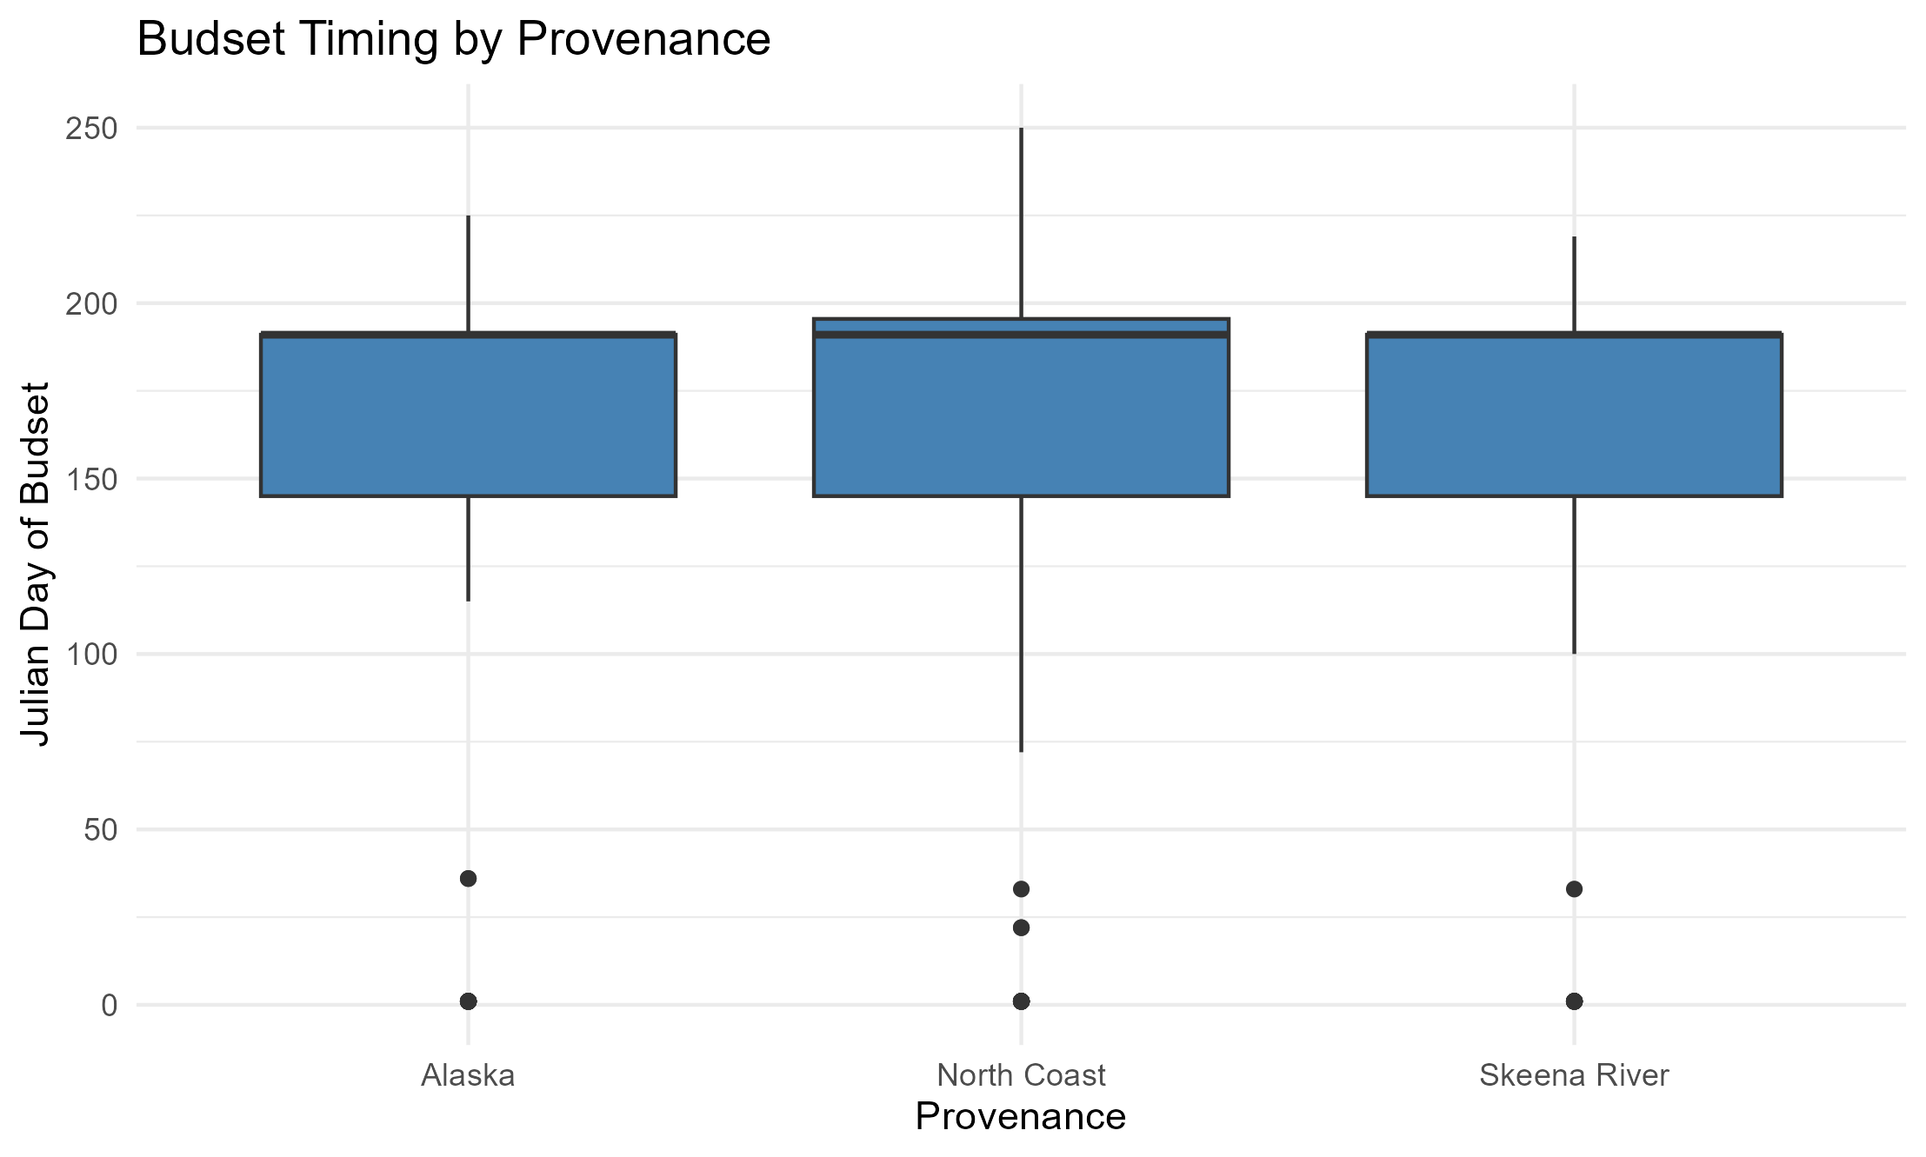
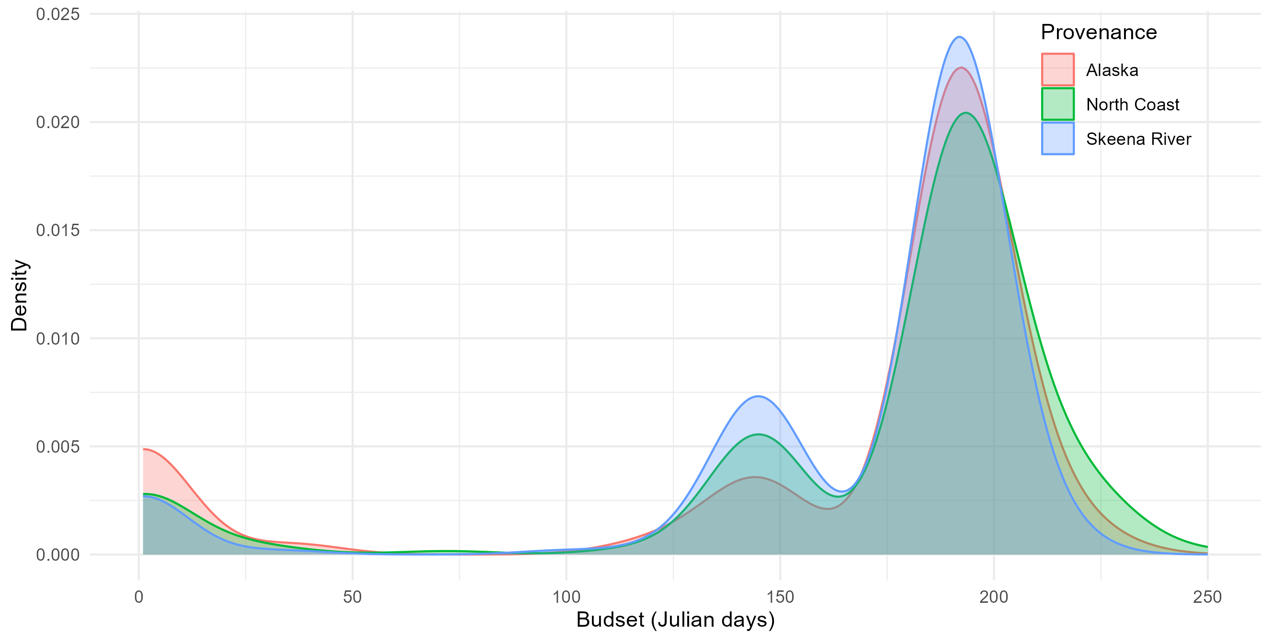
Budset – by provenance
0.042
Even distribution between provenances
Origin date = 10/09/2023
Notes:
North coast n=50

Slide 17
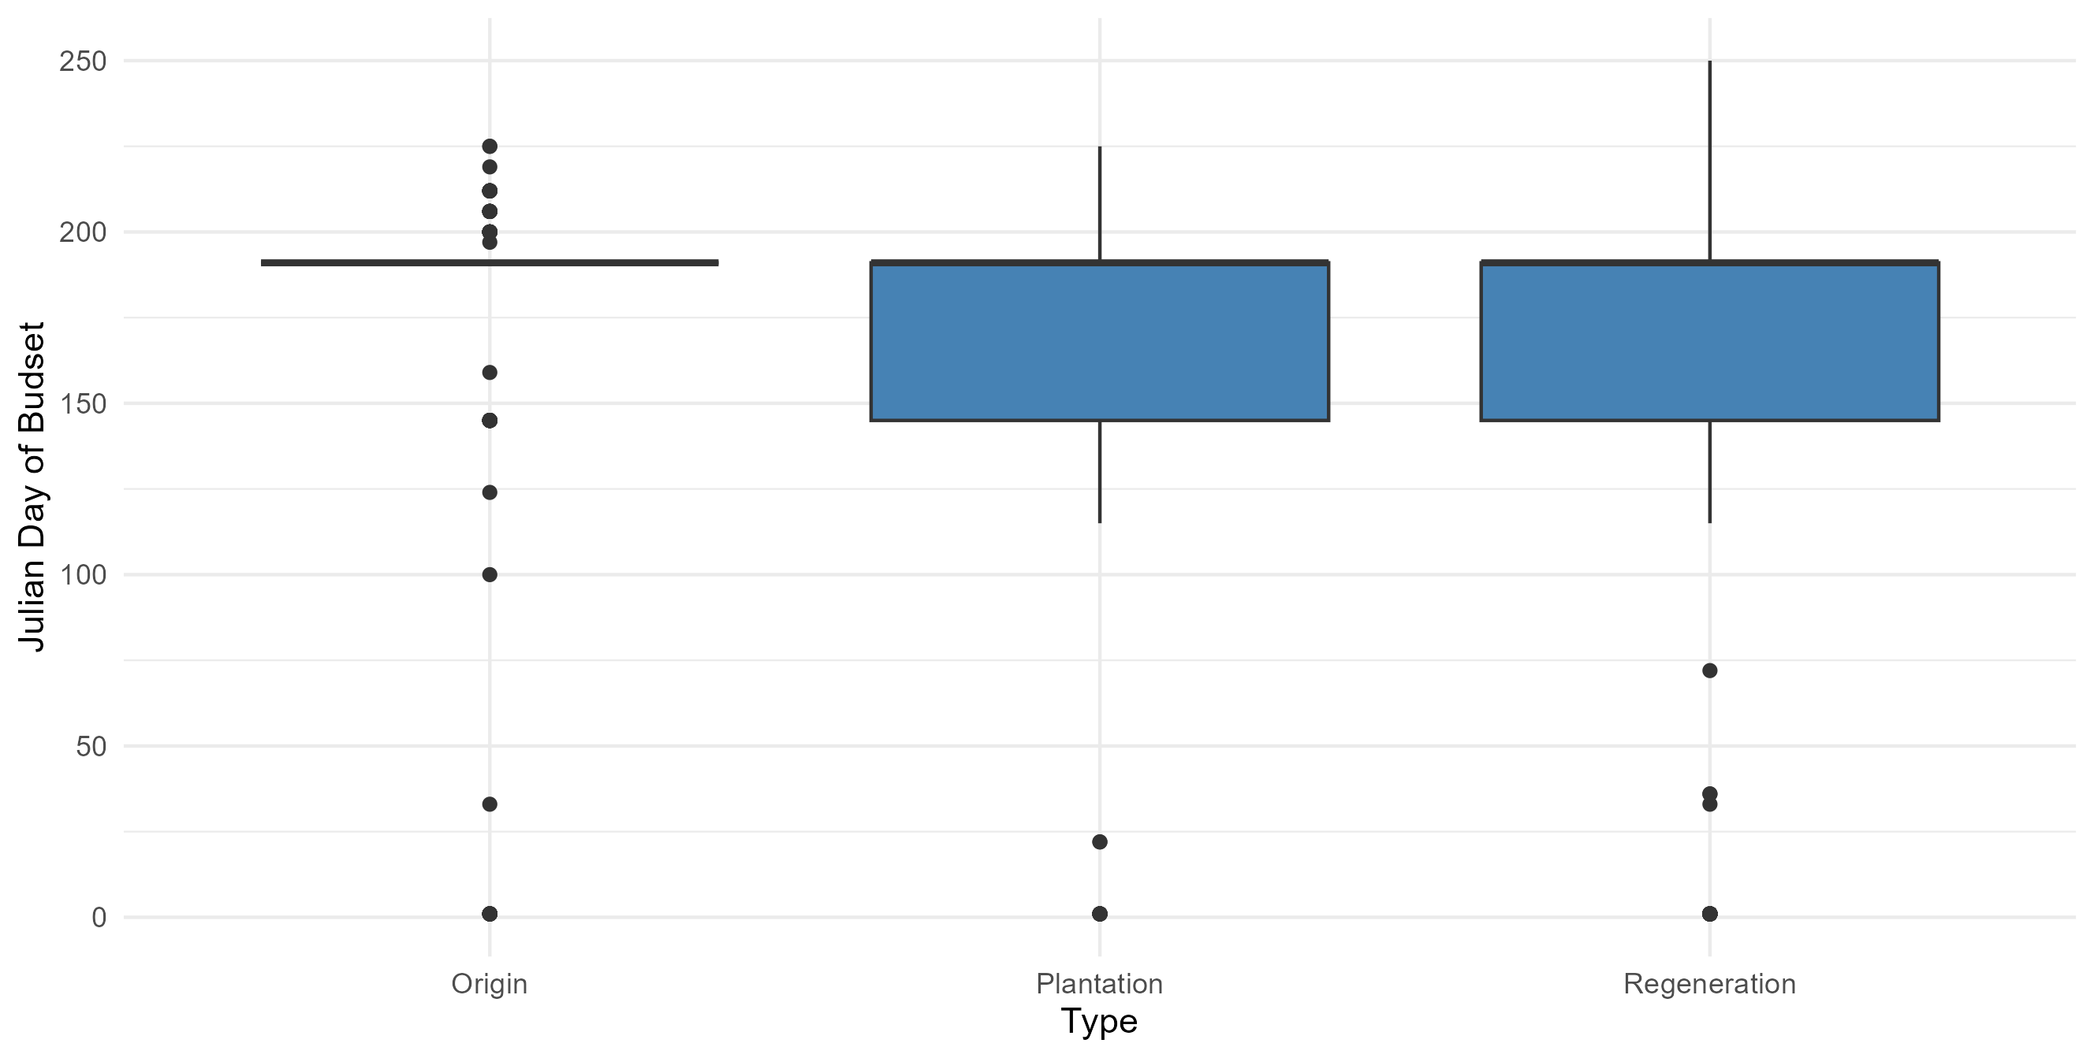
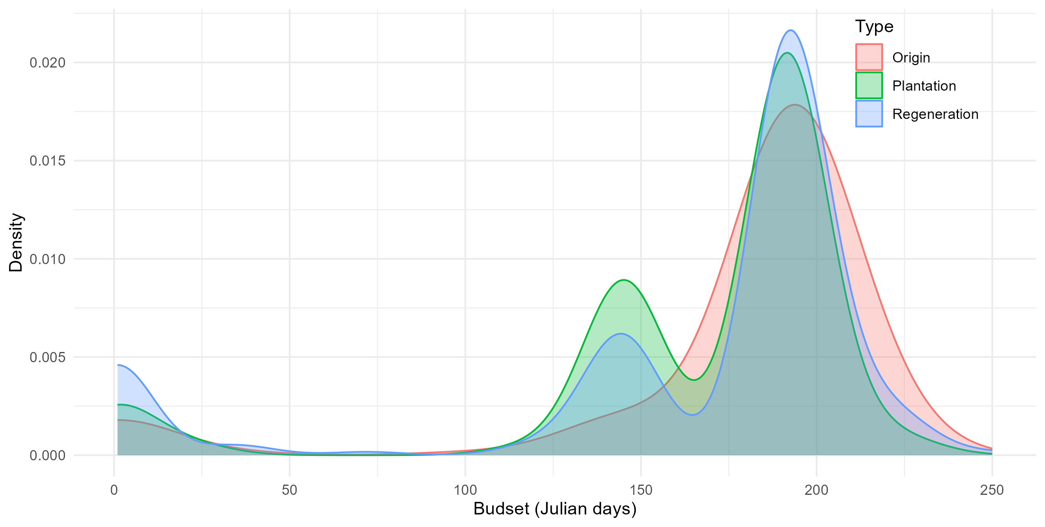
Budset – by Cohort
*
*

Slide 18
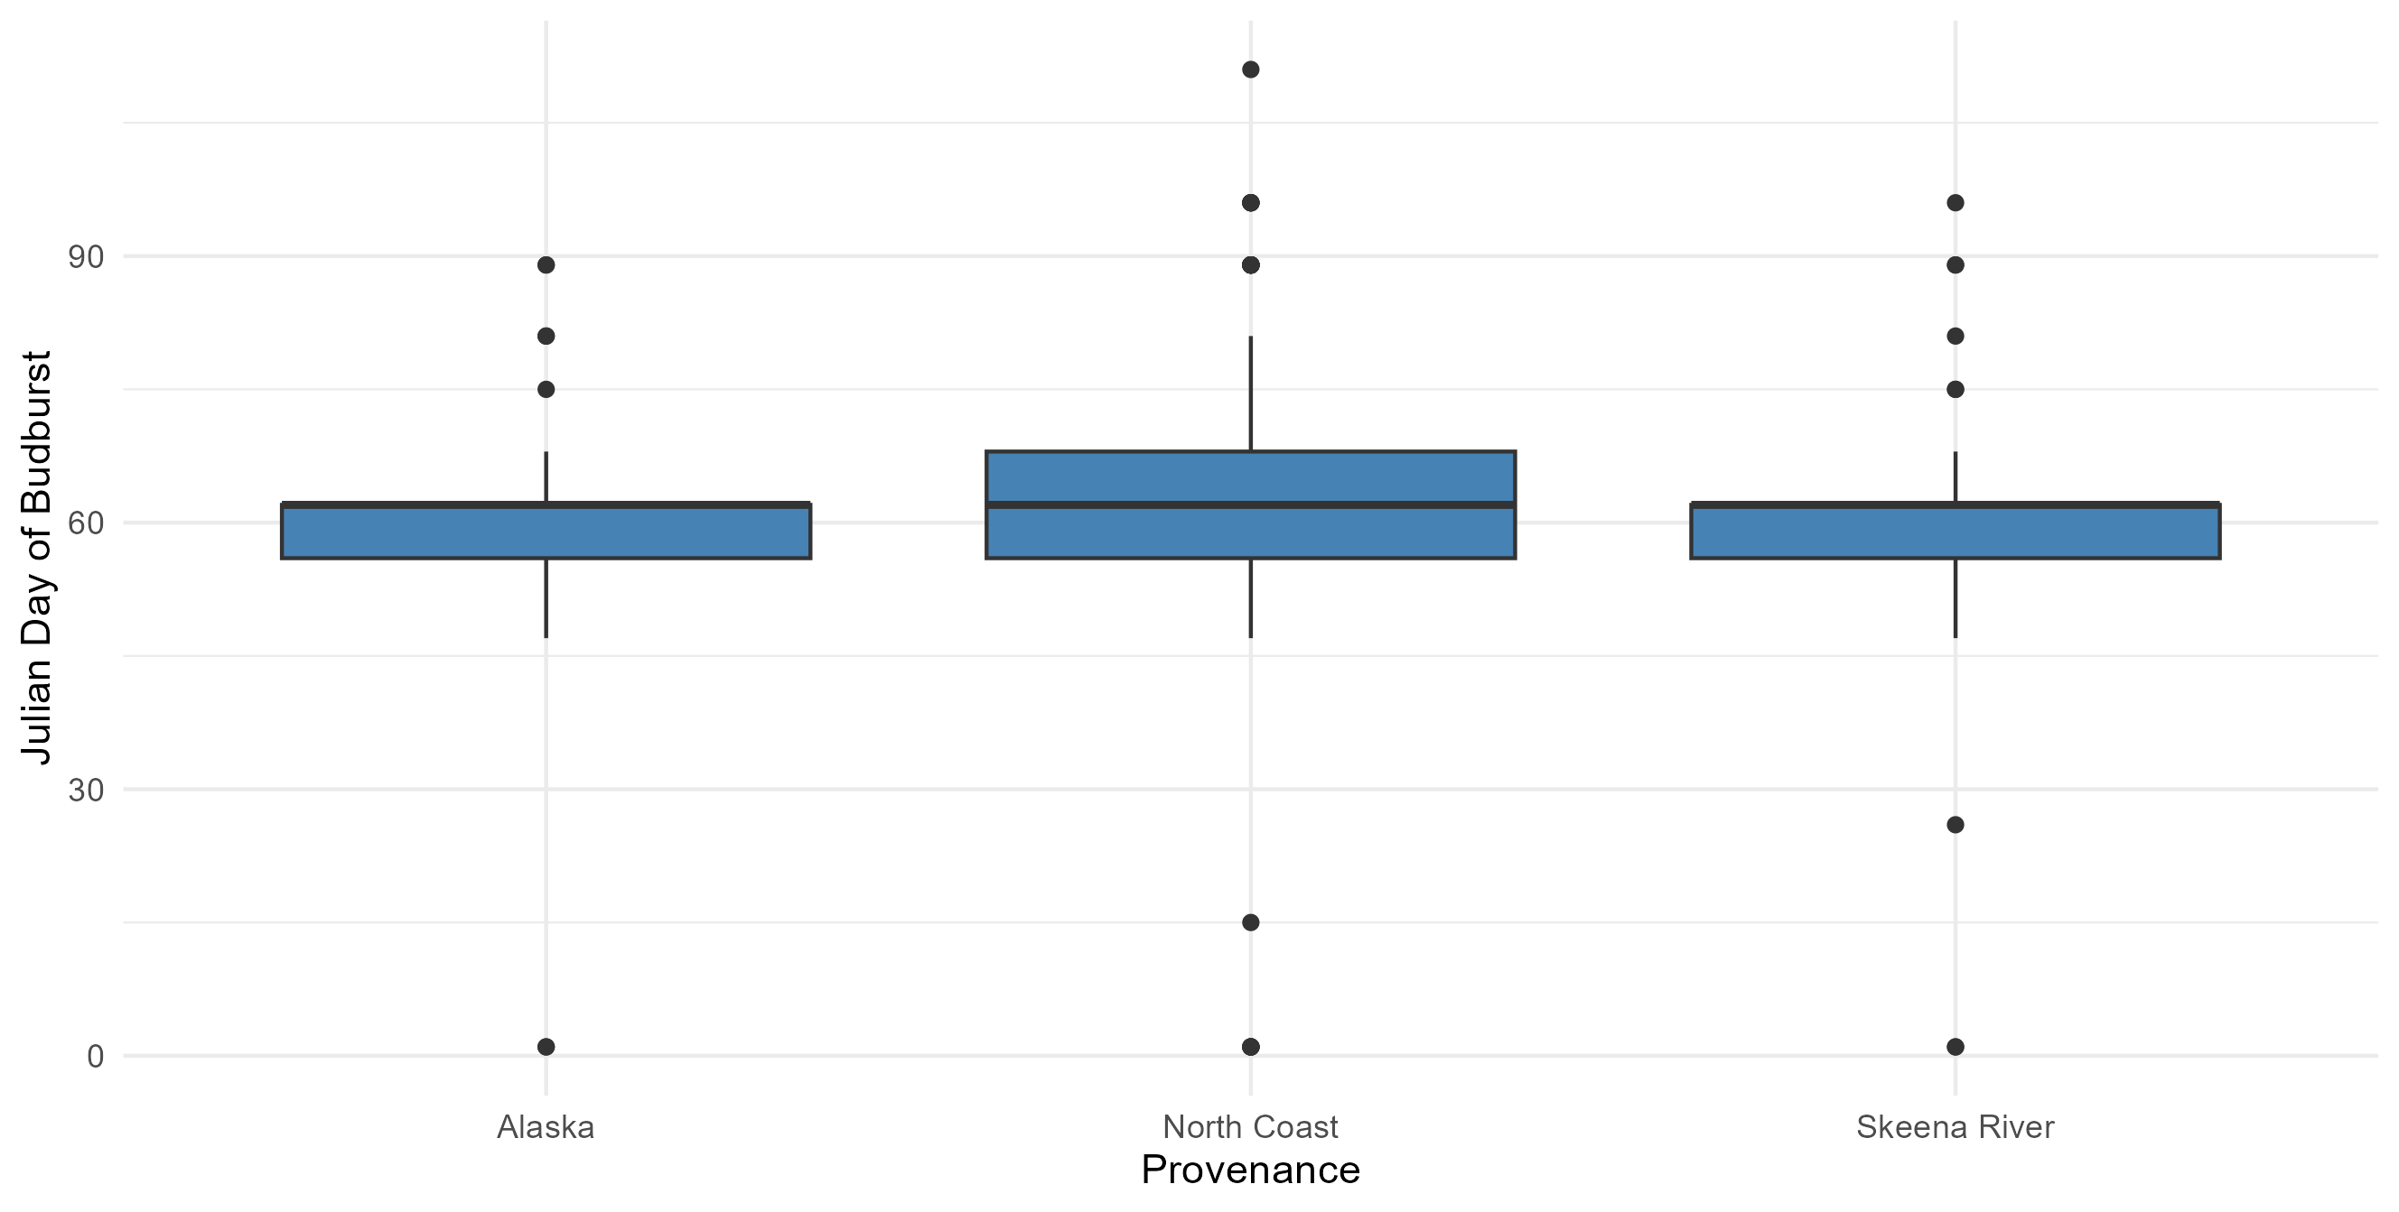
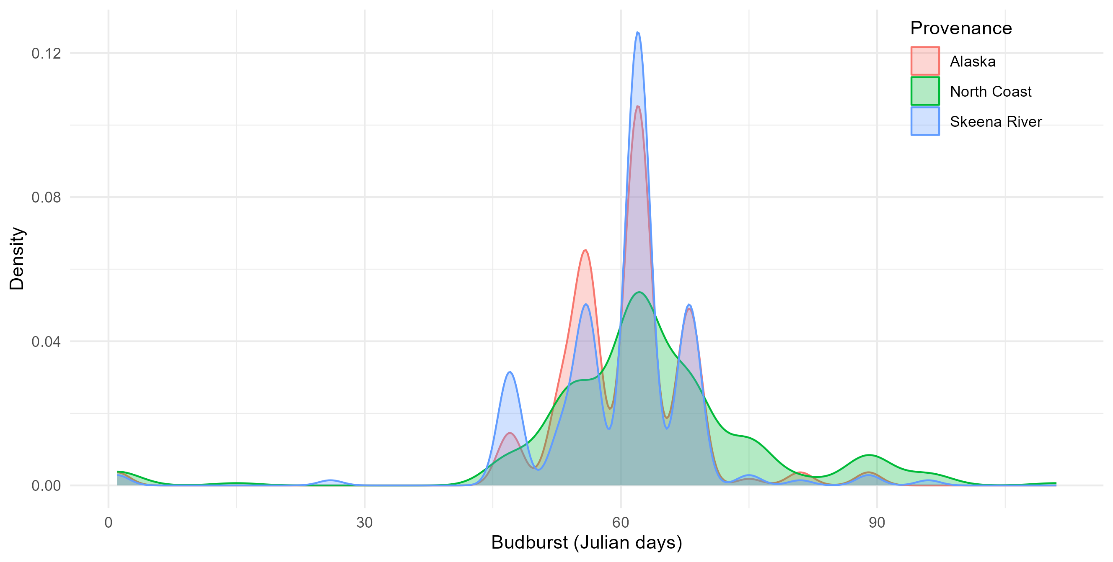
Budburst – by Provenance
Day 0 = 01/02/2024
0.013
0.01

Slide 19
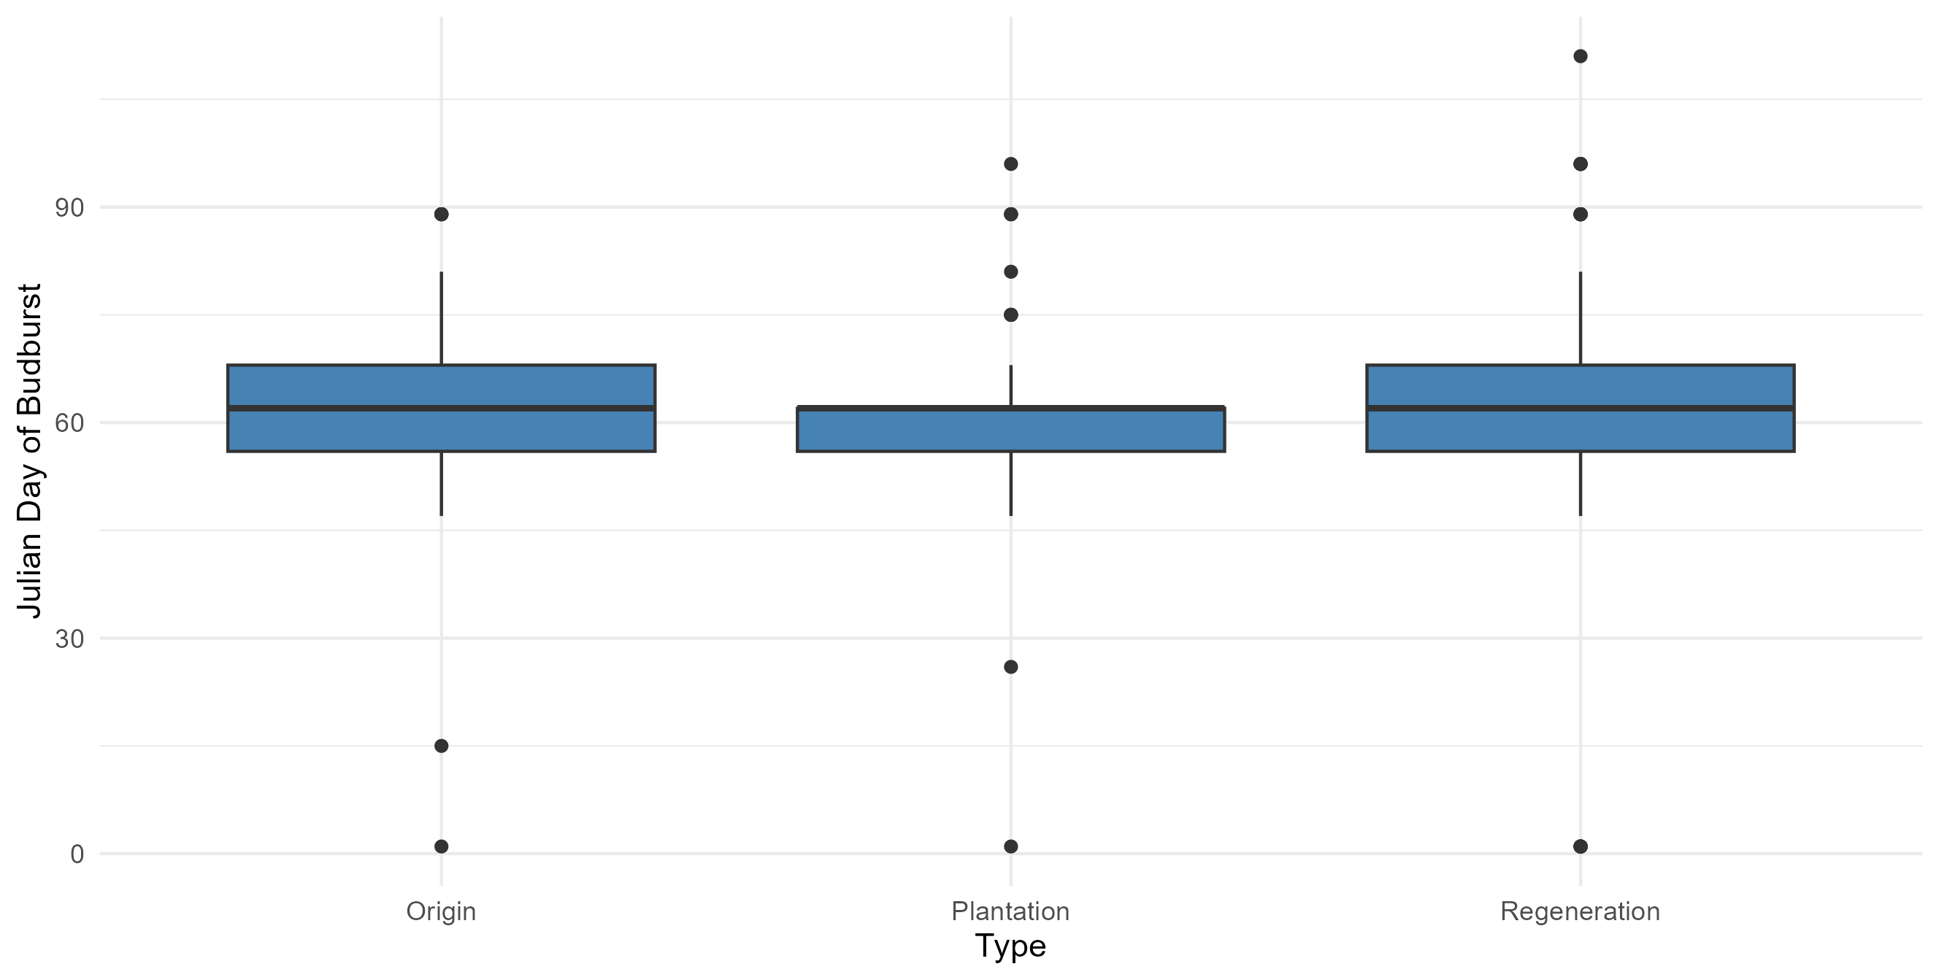
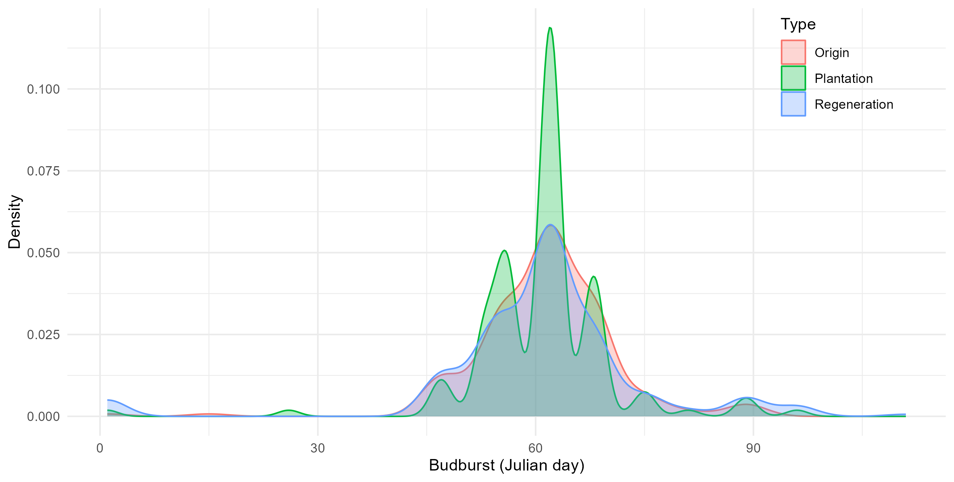
Budburst – by Cohort

Slide 20
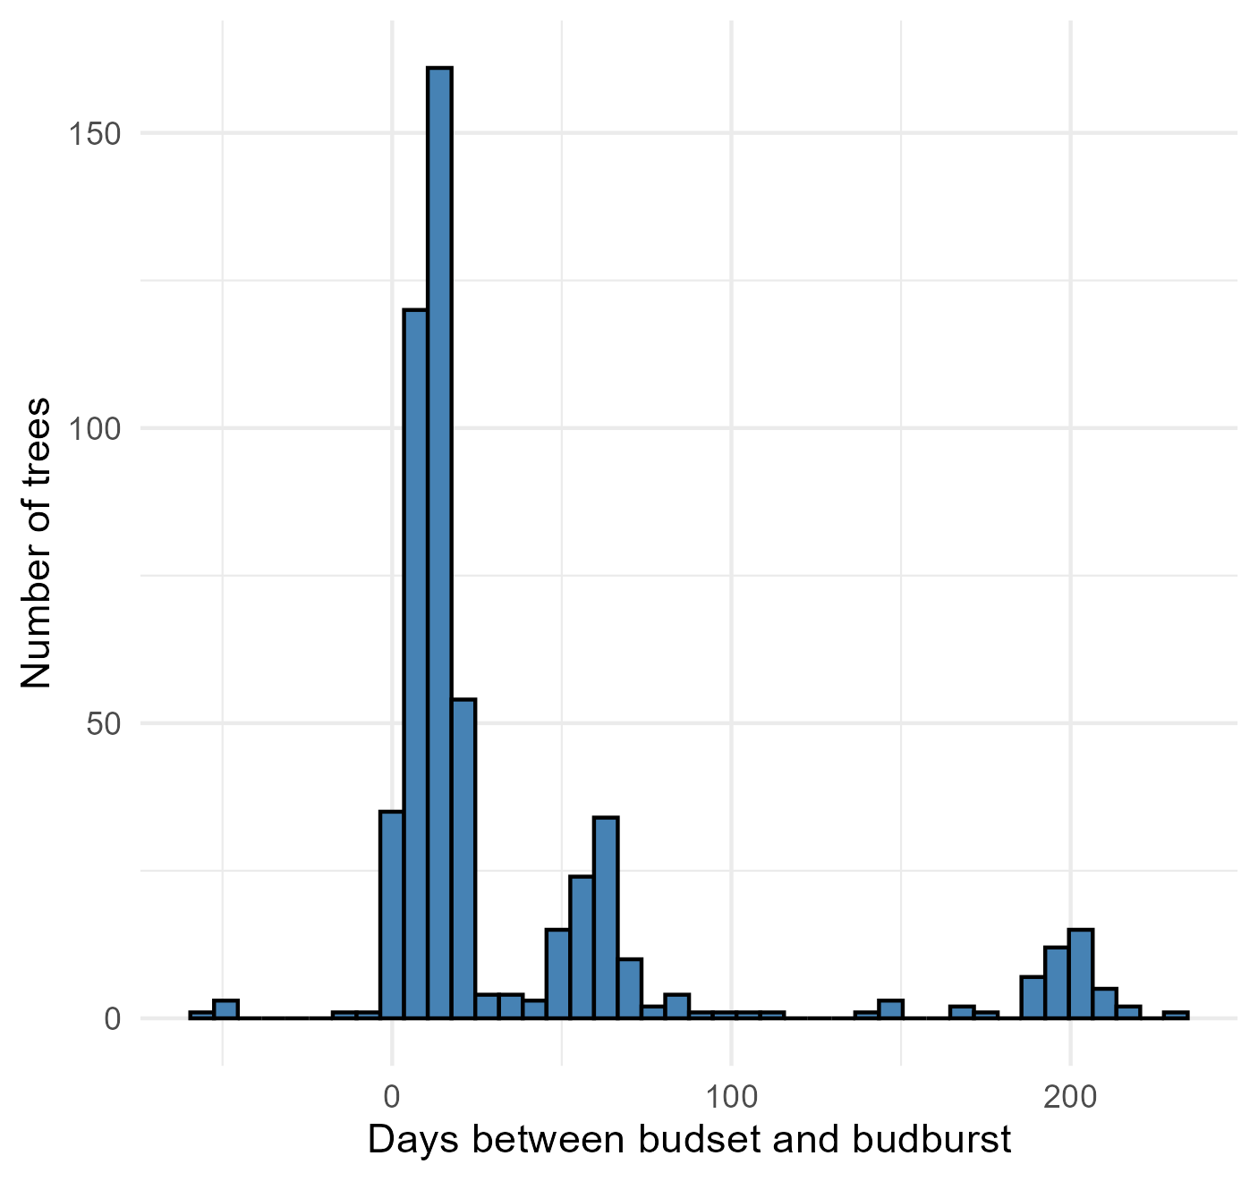
Difference between budset and budburst
4 Regen (Rowens, North Coast)
6 trees with budset recorded after budburst
1 Plantation (Rowens, North Coast)
1 Origin (Alaska)
Notes:
Plot met office daylength or temperature data
6 trees with budset after budburst
(no budset recorded, then budset & budburst simultaneously, then "second" budset afterwards??)
Probably error in calculating date → check original records

Slide 21
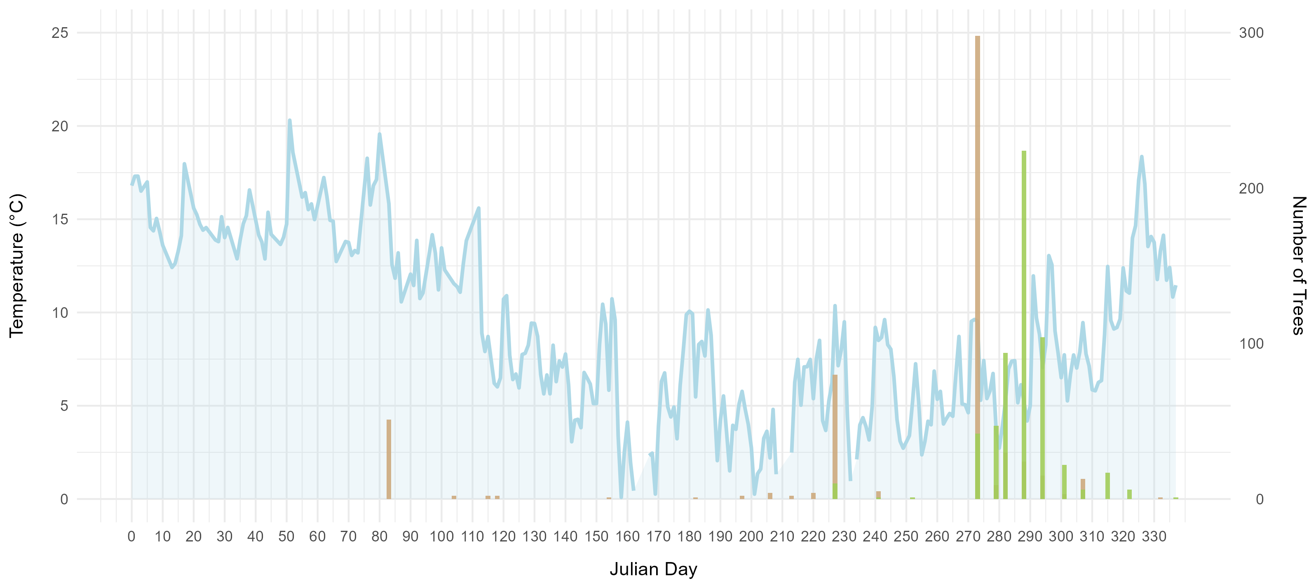
BS & BB data with temperature
budset
budburst

Slide 22
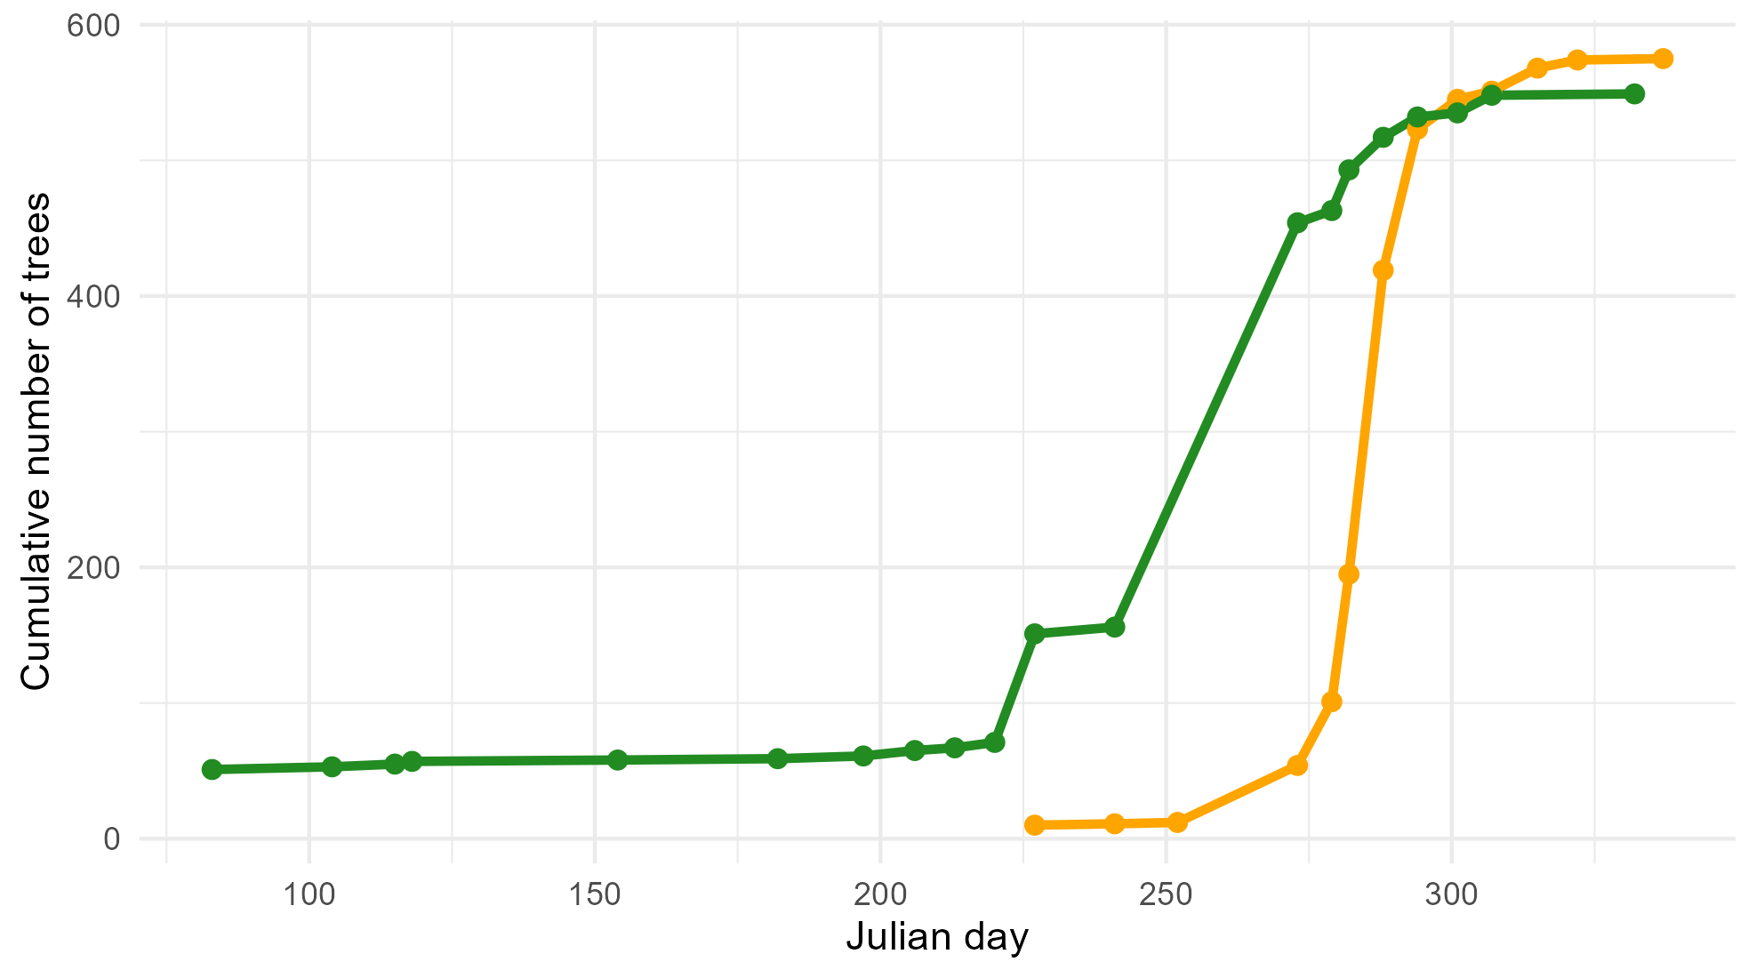
Cumulative BS/BB curve
Budset
31/01/2024
Budburst
25/04/2024
Notes:
(per provenance/Cohort)

Slide 23
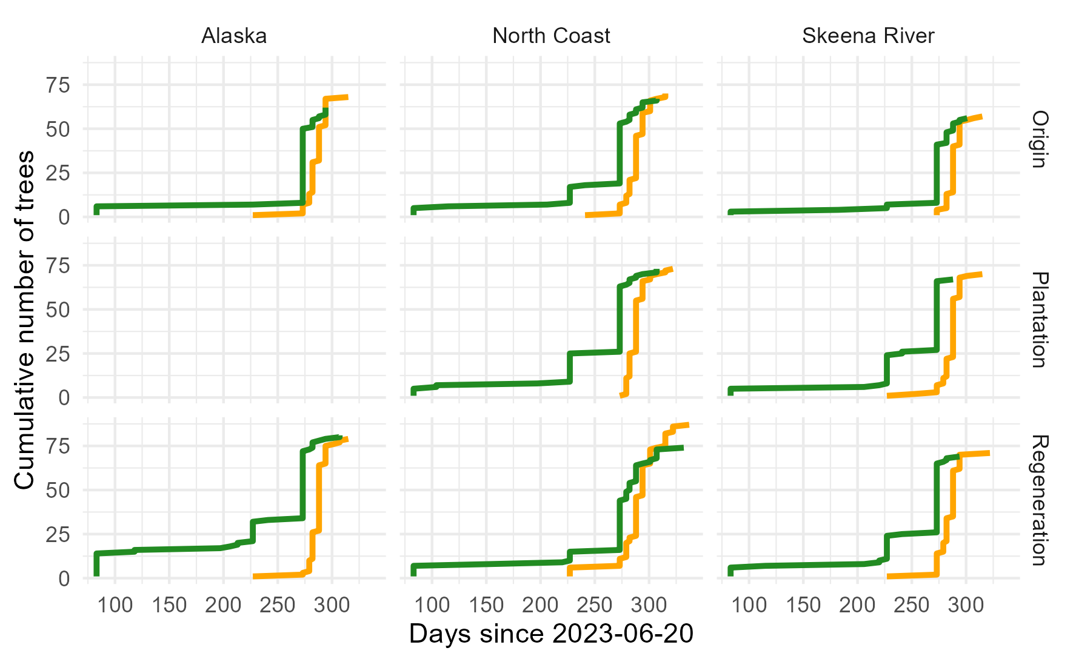
Cumulative phenology – by Provenance and Cohort
No obvious differences
- Maybe North Coast Plantation & Skeena River Origin: budburst starts later, goes quicker

Slide 24
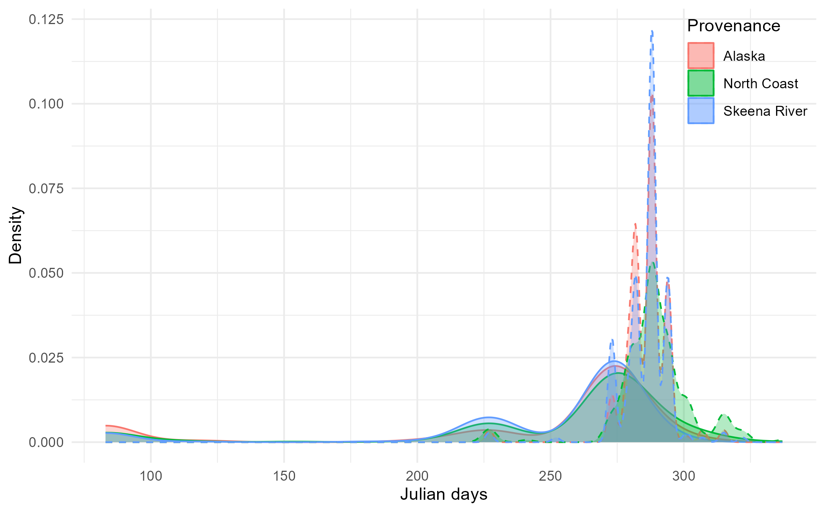
Budset & Budburst - Provenance
Origin date (planting date) = 20/06/2023
Budburst
Budset

Slide 25
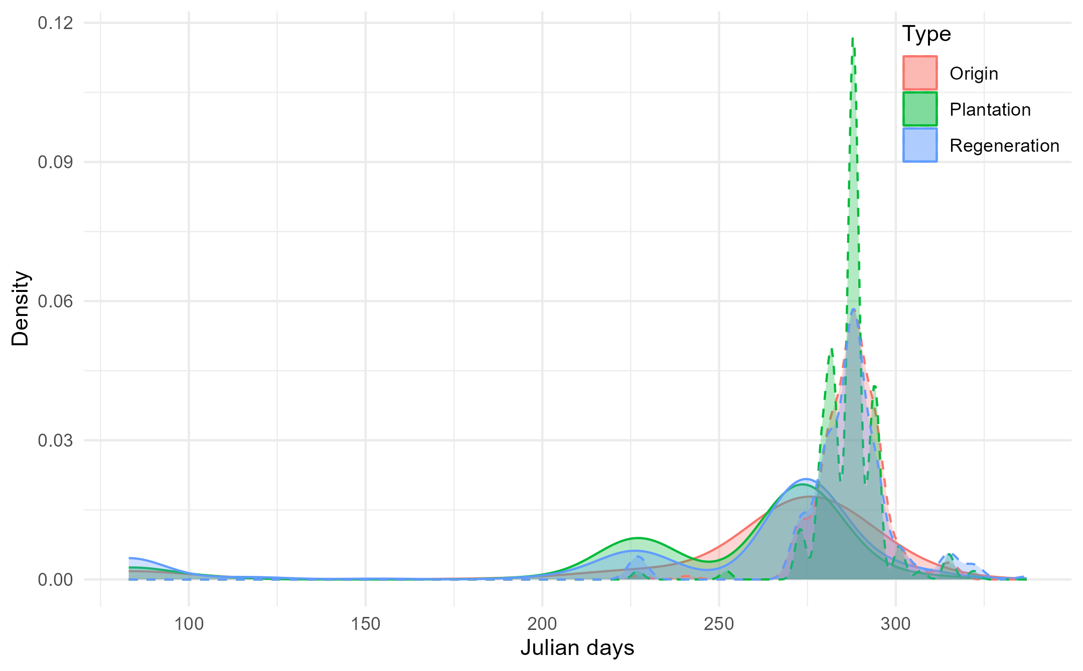
Budset & Budburst - Cohort

Slide 26
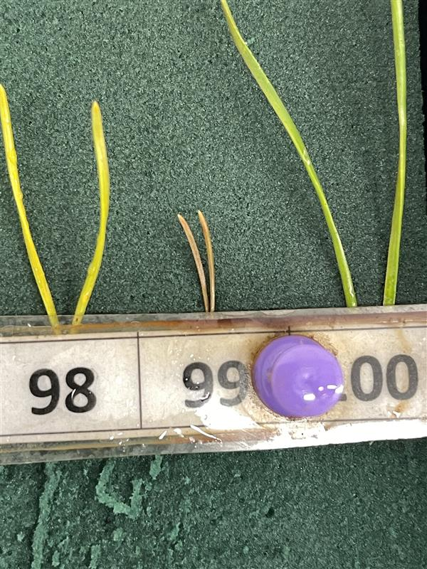
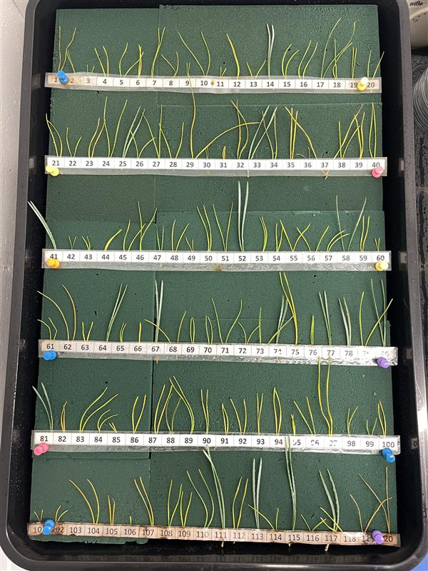
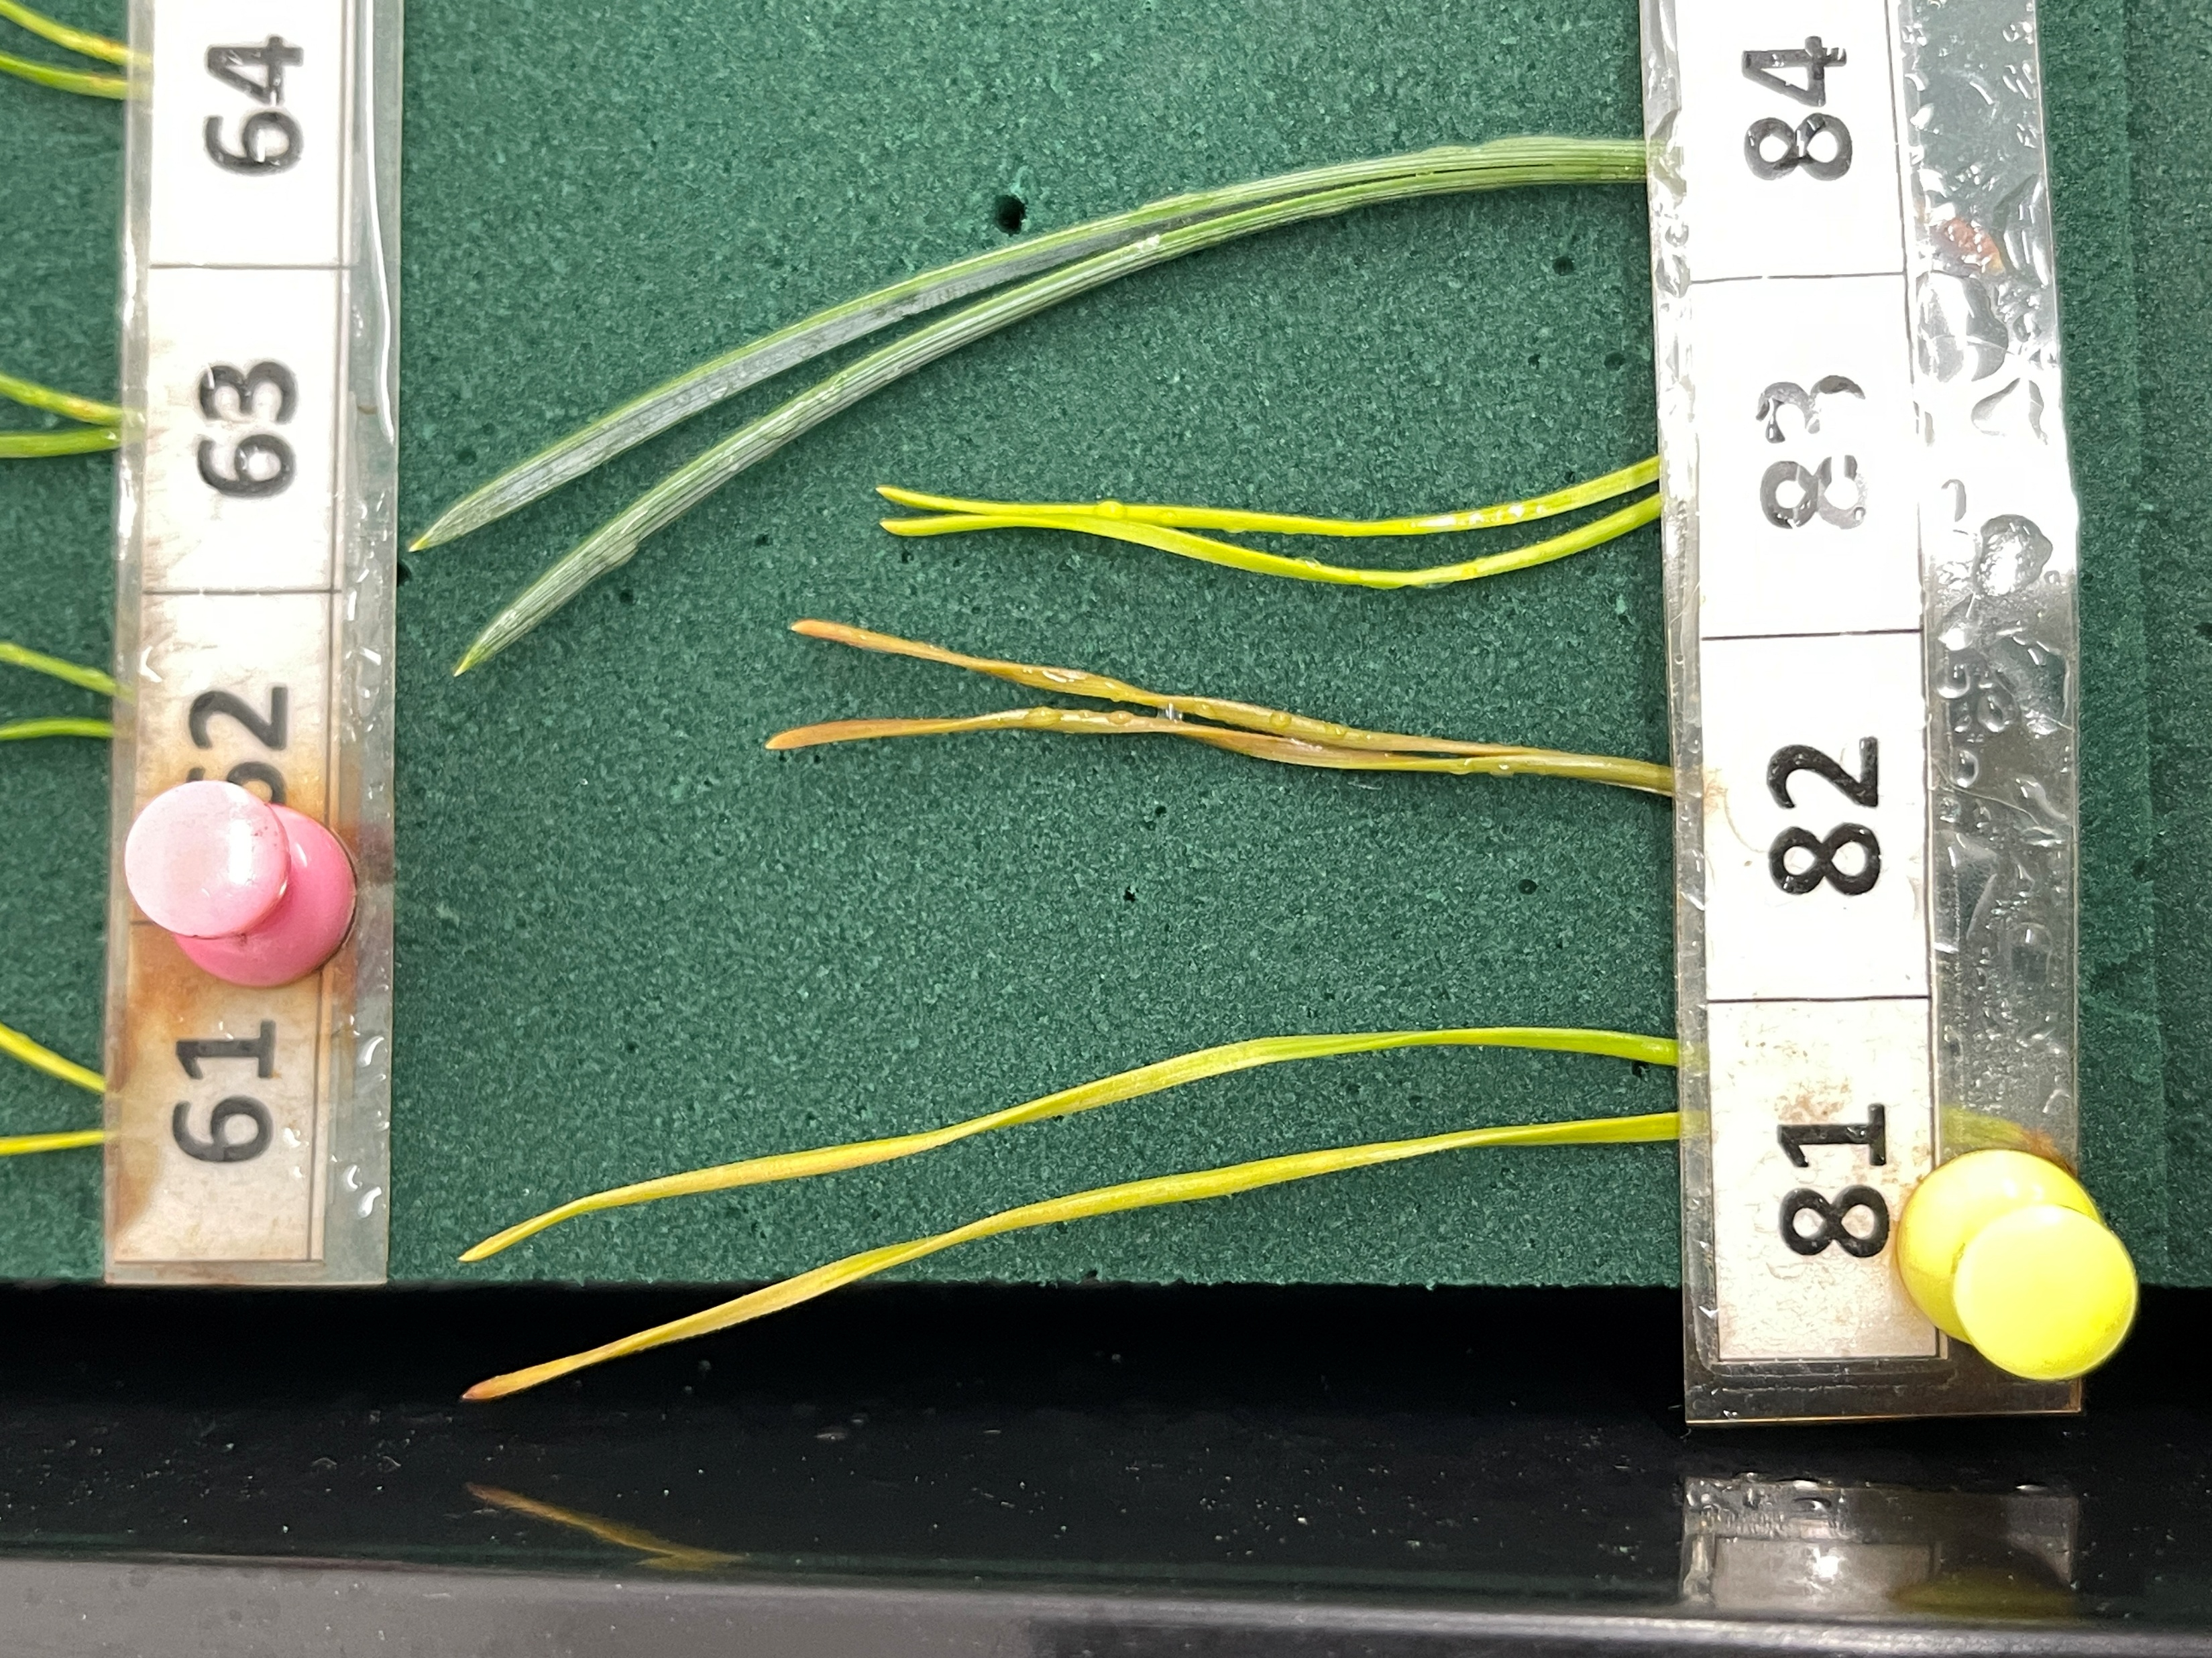
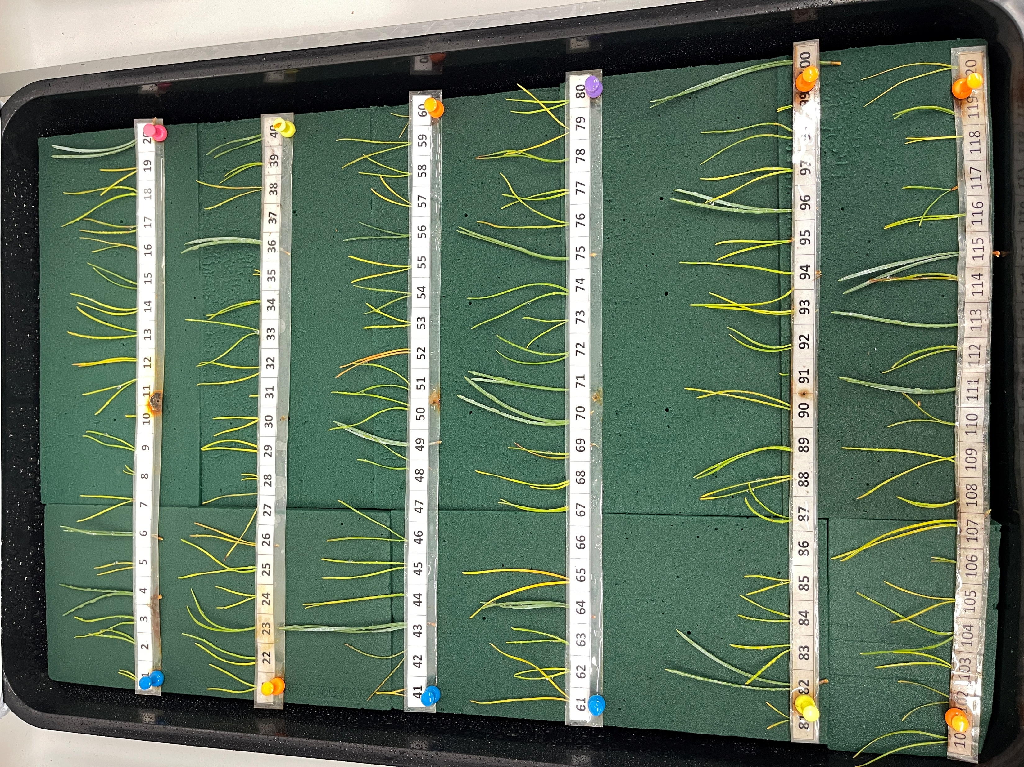
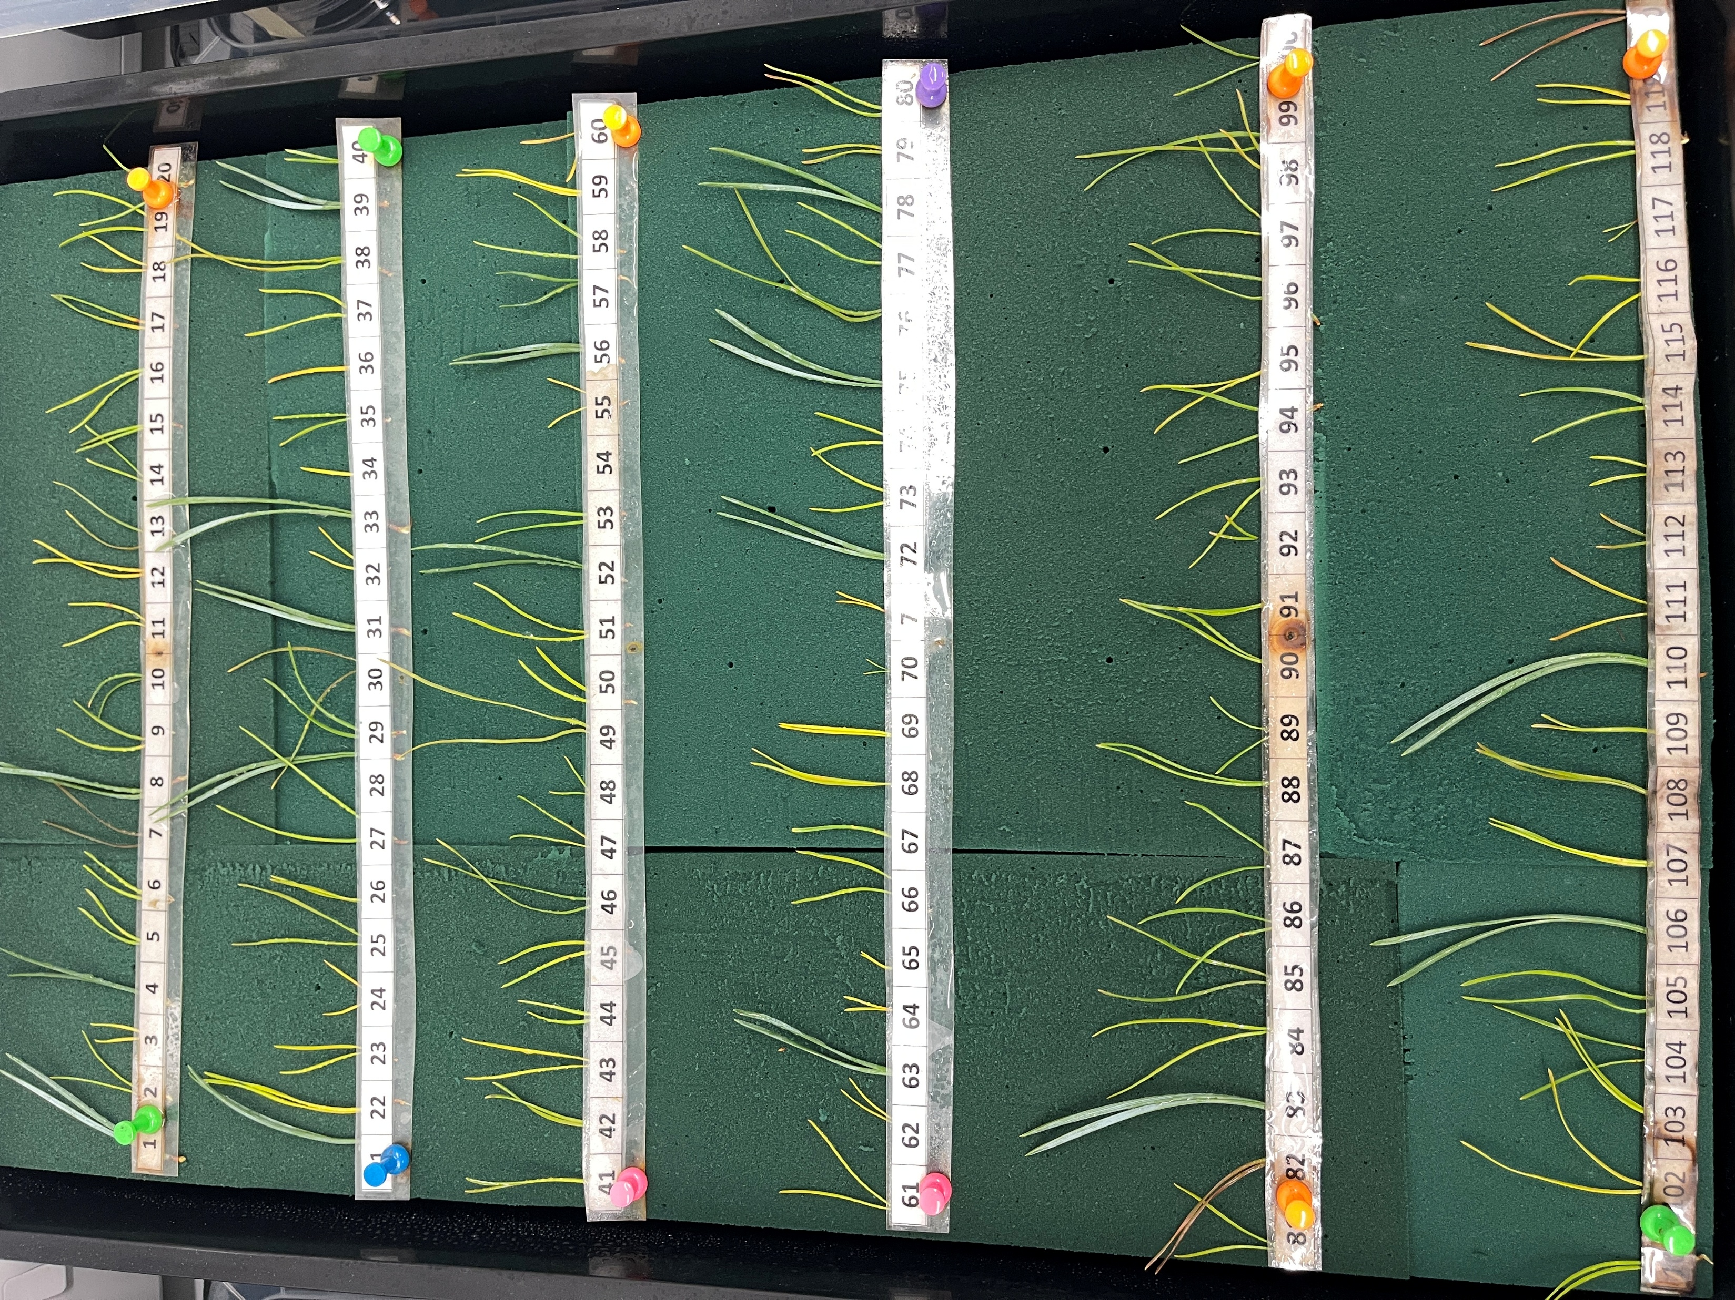
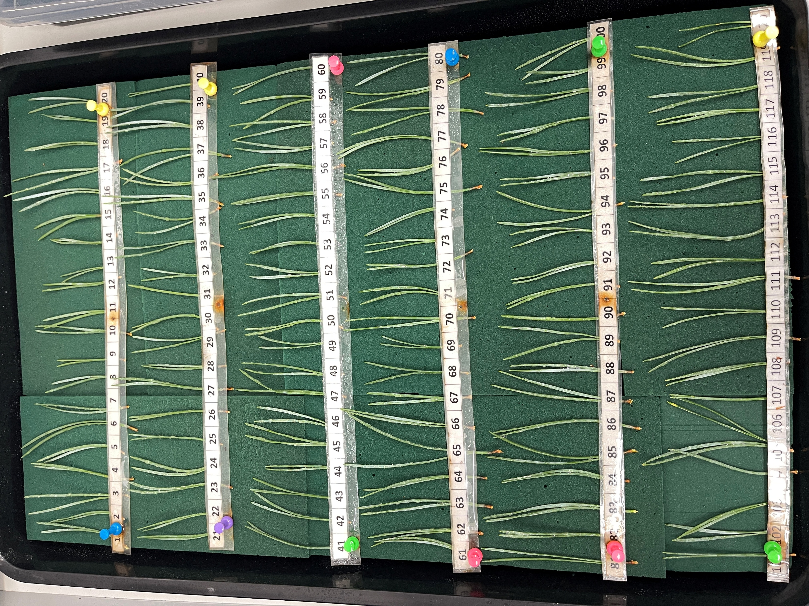
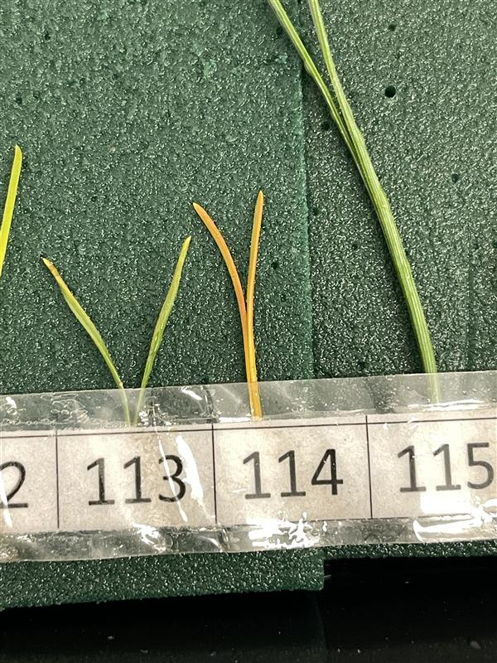
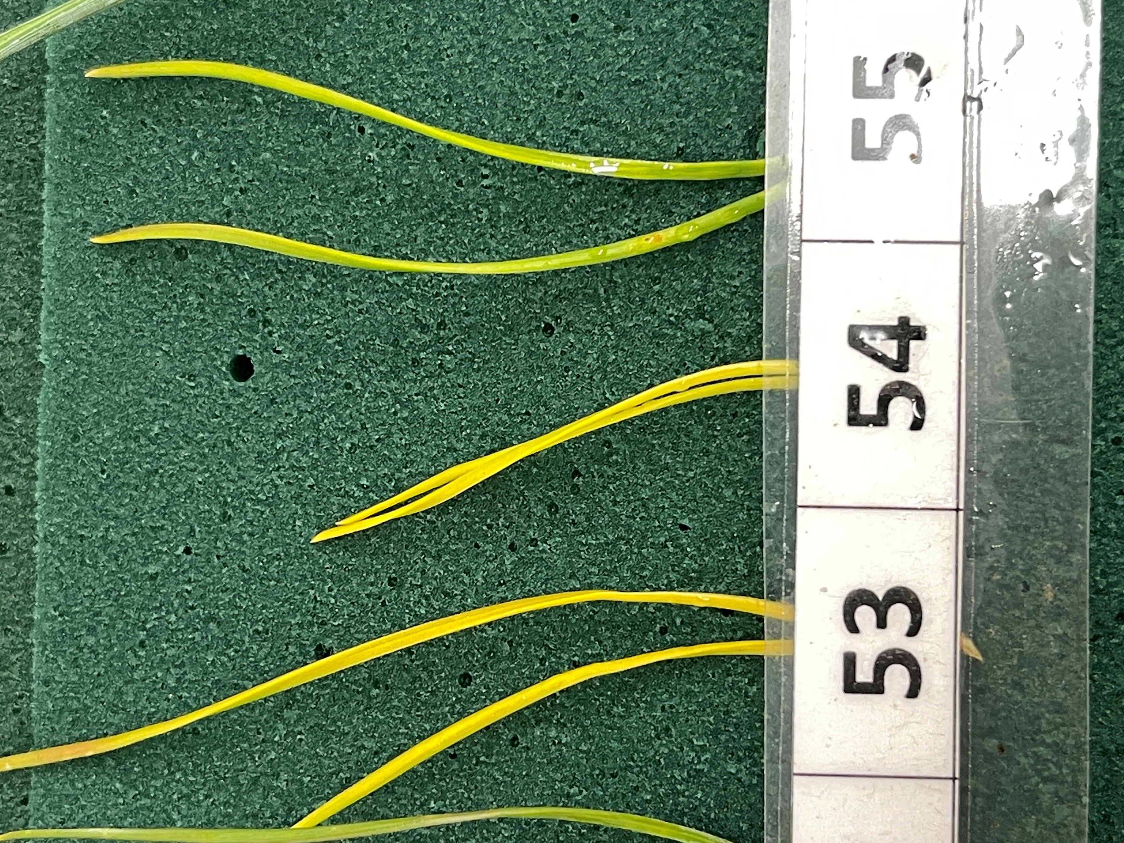
Bioassay analysis

Slide 27
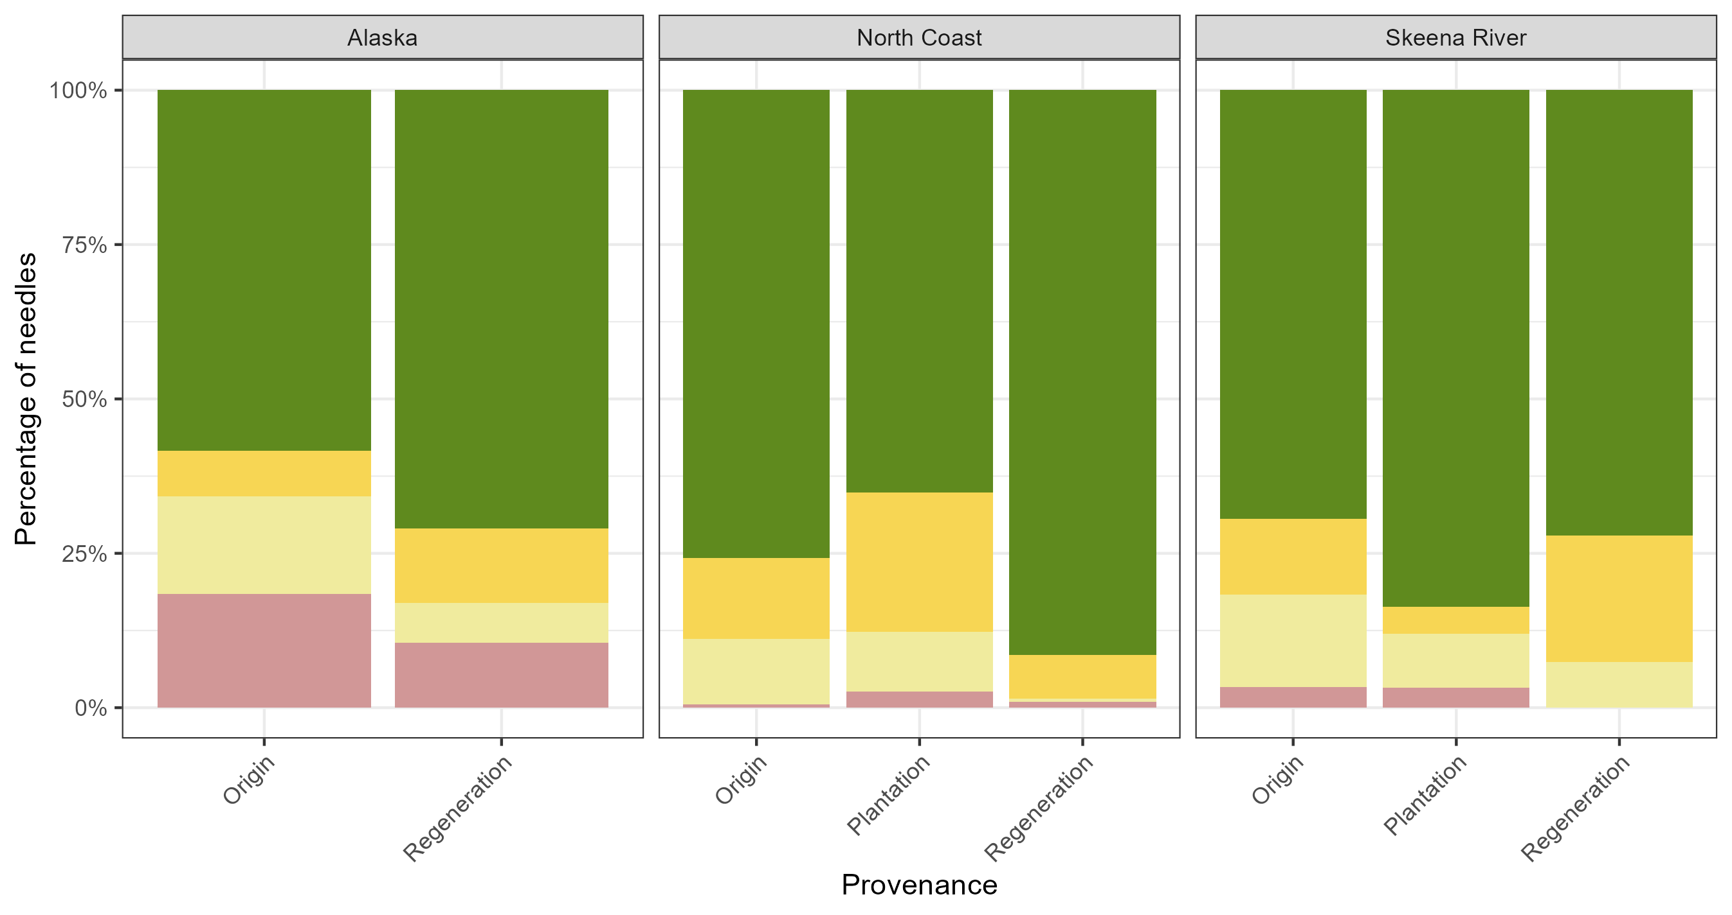
Needle colour – Day 0

Slide 28
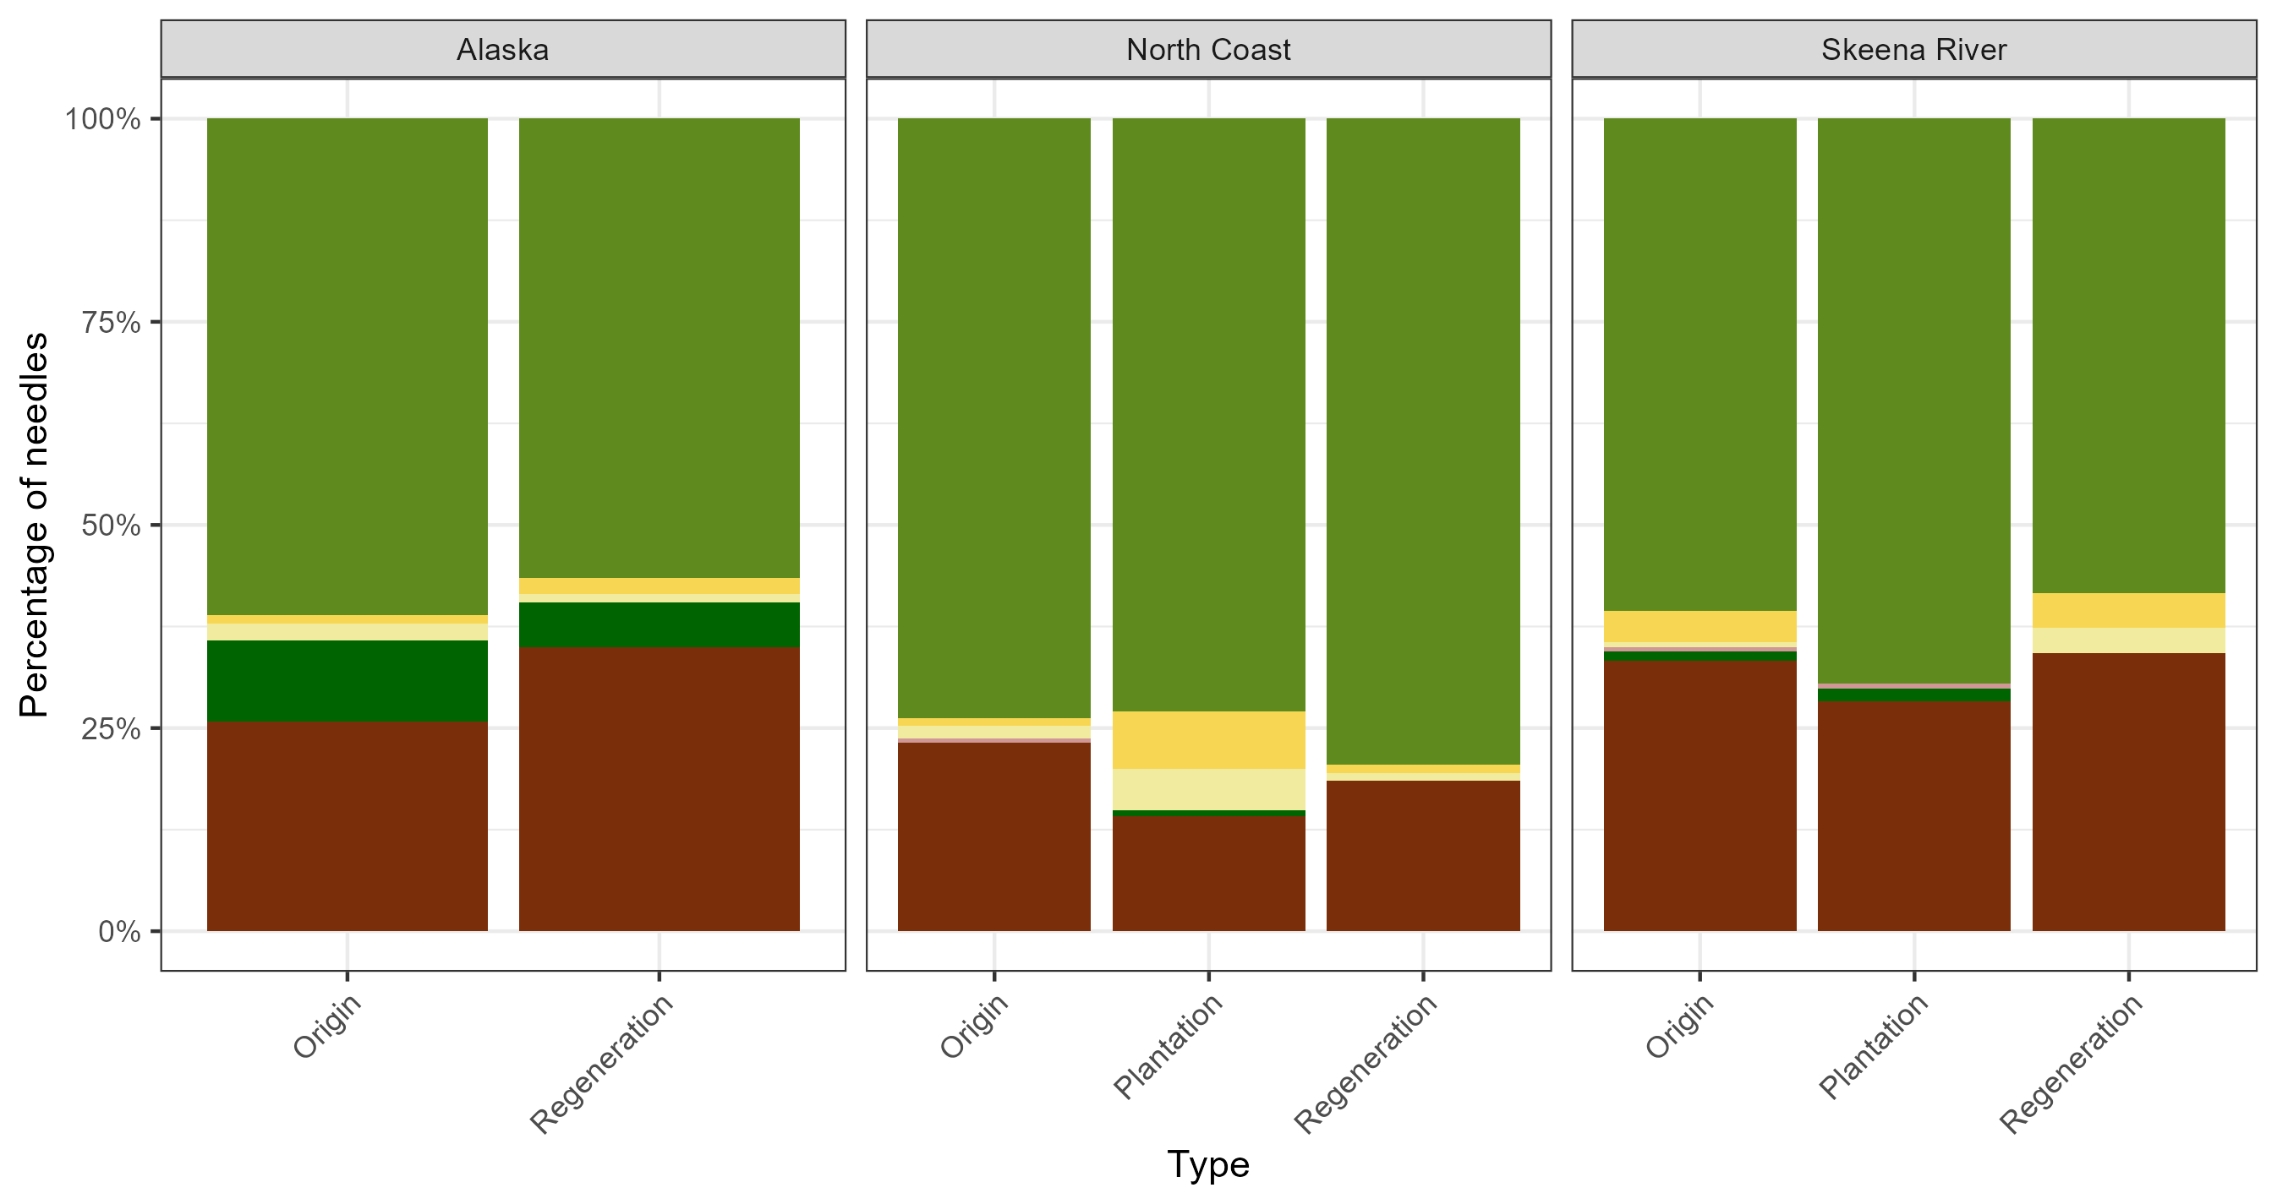
Needle colour – Day 49

Slide 29
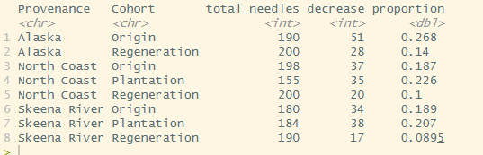
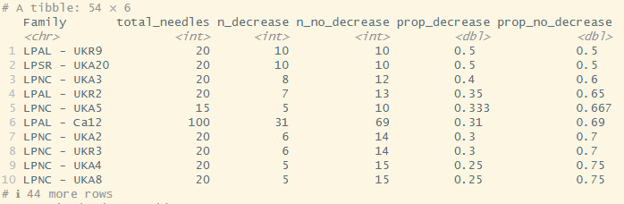
Up then down
Needles whose scores either:
Higher at beginning, then decrease
Increase, reach peak and then decrease again
Notes:
Sort families by proportion up down needles
Which needles start with non-zero? Do they belong to certain families?
No statistical test for whether family influences whether needle goes up down

Slide 30
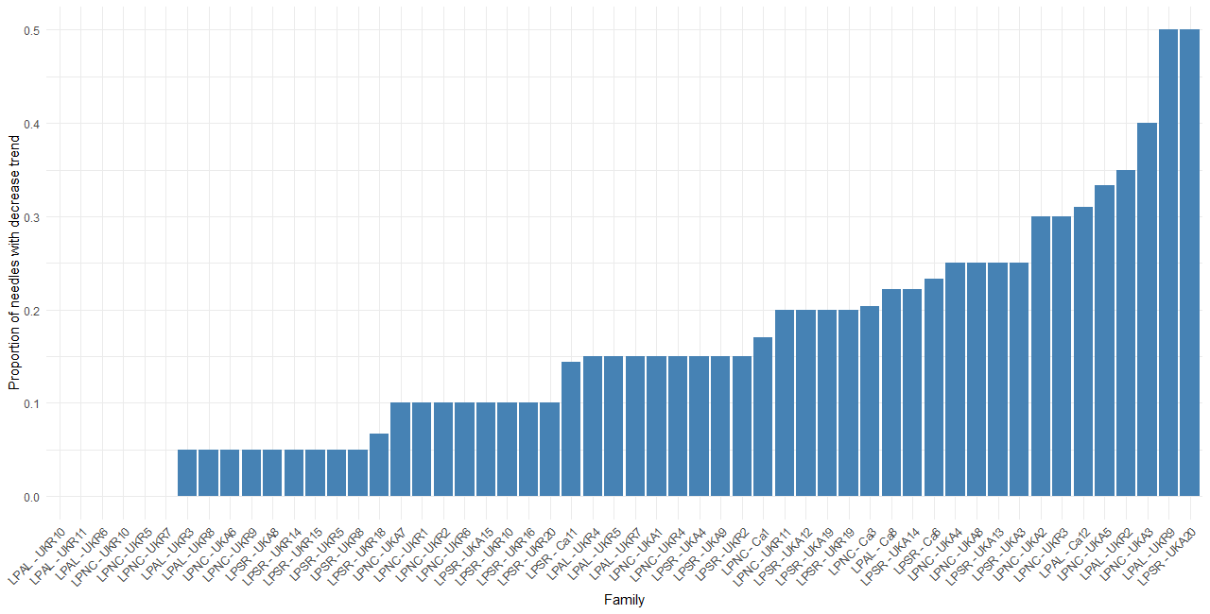
Decreasing scores
No needles with decrease in scores

Slide 31
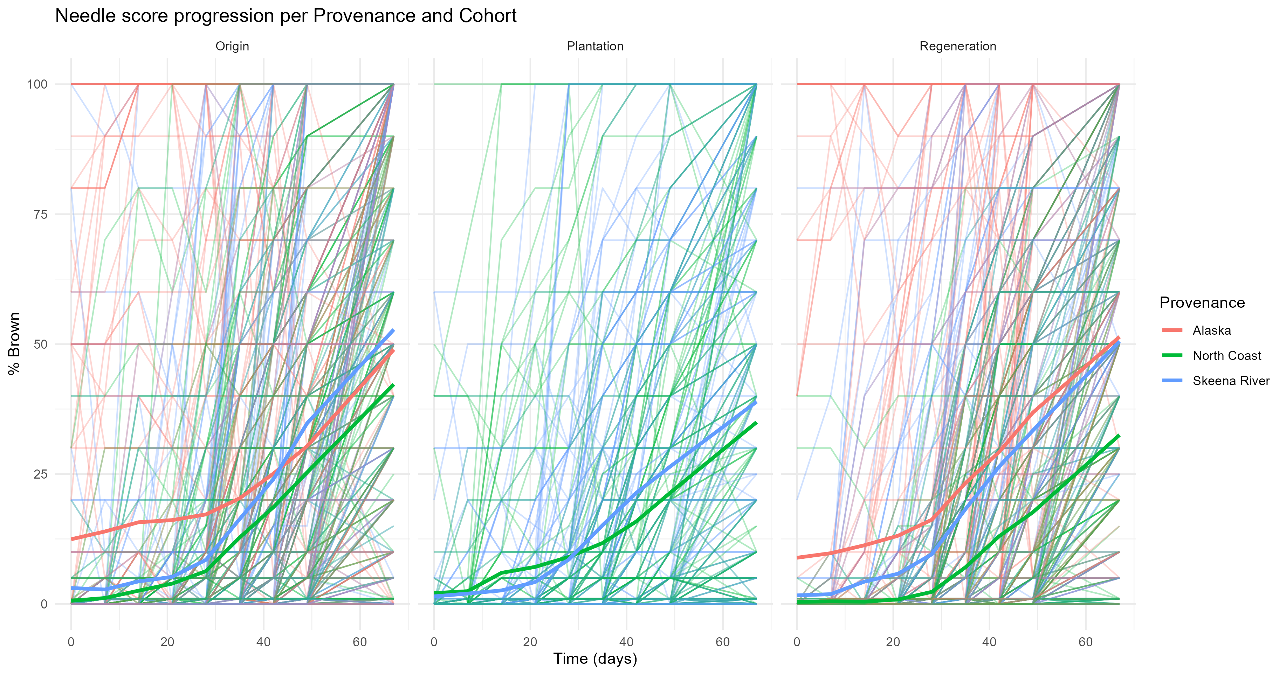
Score progression
Notes:
Maybe remove those that go up down

Slide 32
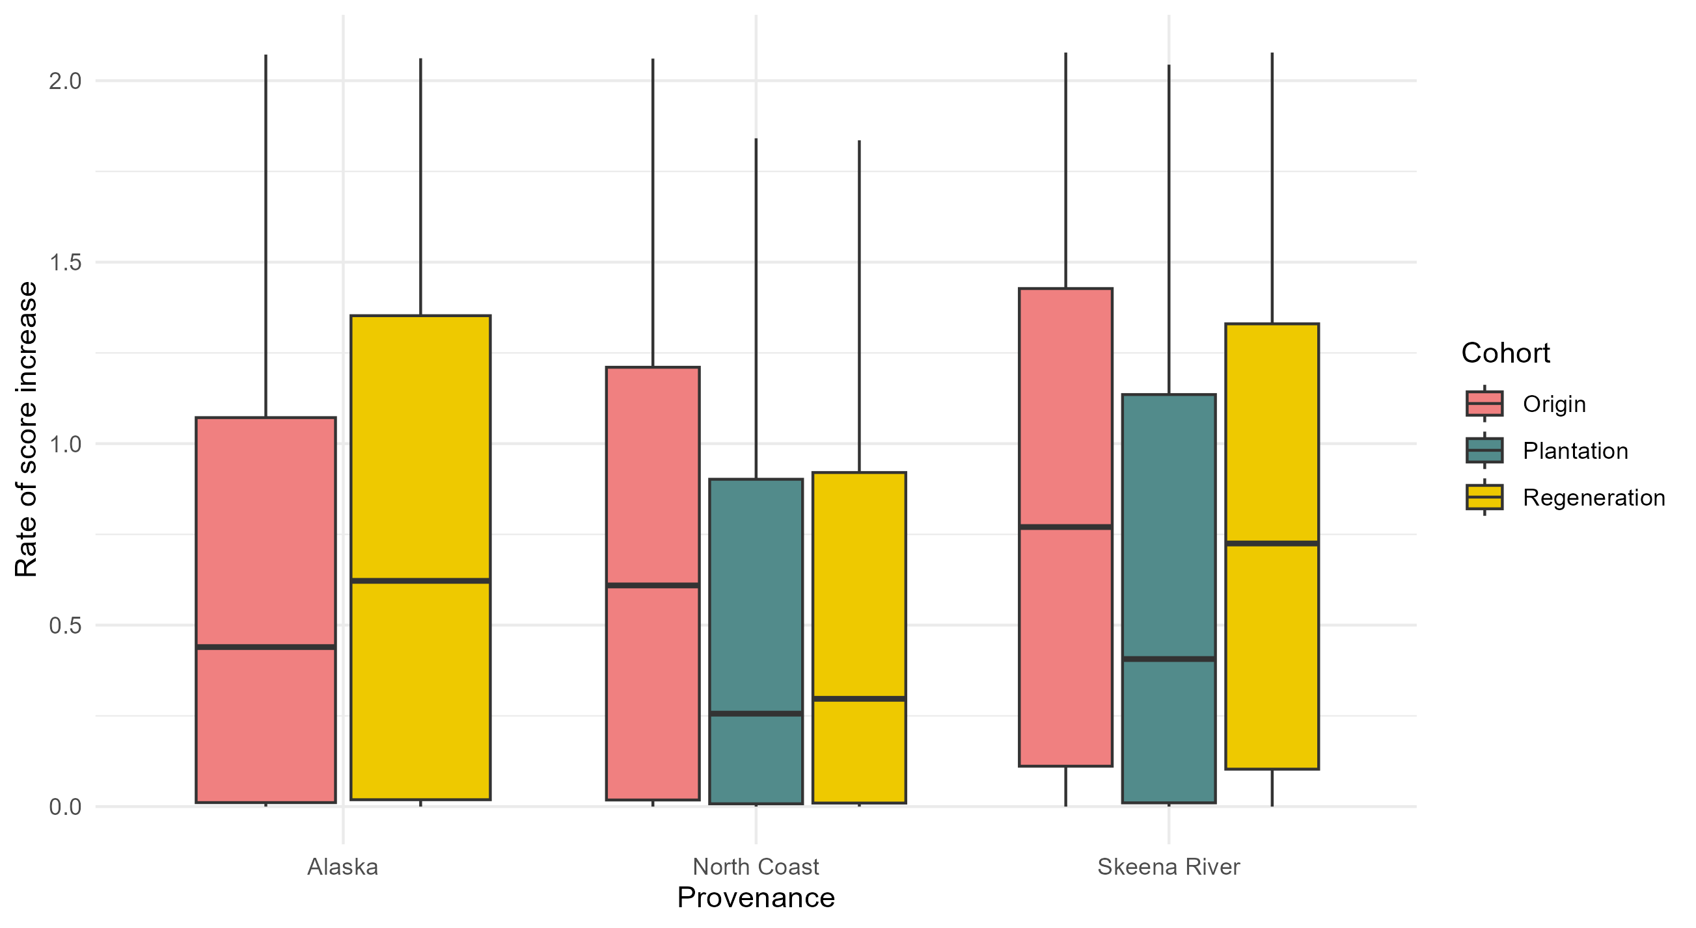
Rate of increase
Removed all needles whose scores decrease at some point
Fitted slope to remained -> slope = rate of increase

Slide 33
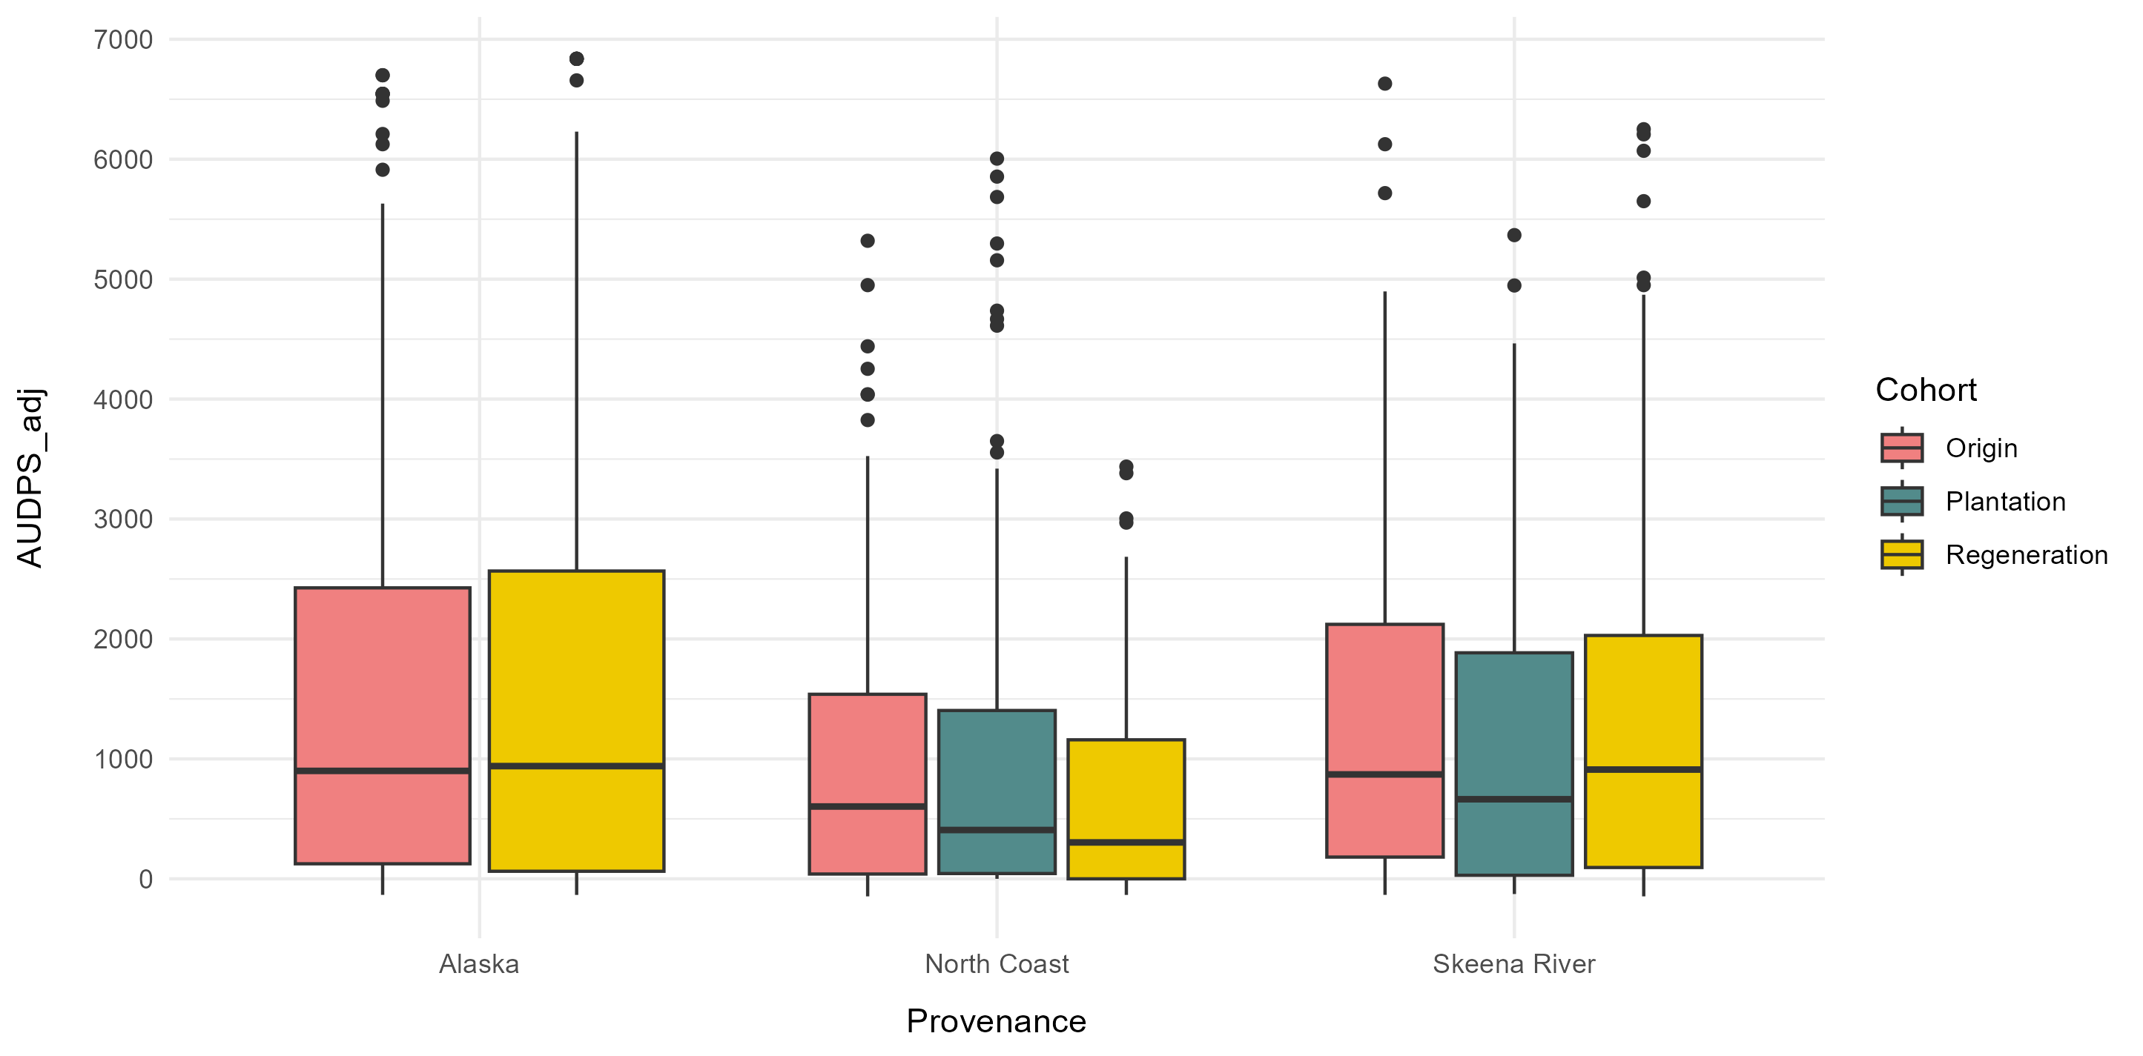
AUDPS (adjusted)

Slide 34
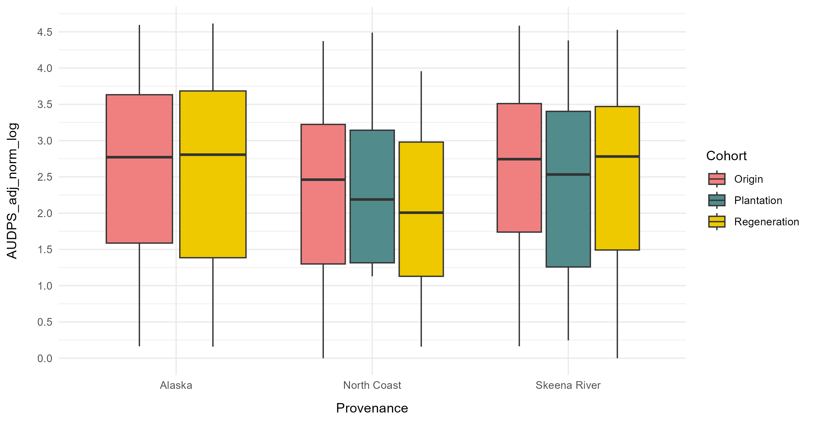

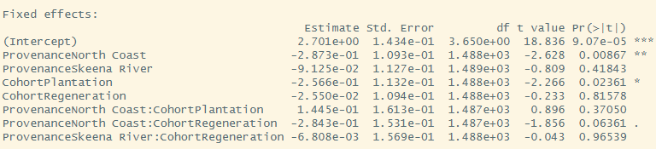
AUDPS (adjusted, standardised, log-transformed)
AUDPS_adj_norm_log ~Provenance * Cohort + (1 | Bioassay)

